Slide 1

Algorithms and Data Structures 2 CS 1501
Spring 2022
Sherif Khattab
ksm73@pitt.edu
(Slides are adapted from Dr. Ramirez’s and Dr. Farnan’s CS1501 slides.)

Slide 2
Announcements
Upcoming deadlines:
Lab 11 due on 4/15
Homework 12 due on 4/18
Assignment 3 and 4 due on 4/18
Lab 12 due on 4/22
Bonus Lab due on 5/2
Assignment 5 due on 5/2
Bonus Homework due on 5/2

Slide 3
Previous lecture …
Cryptography
Caesar Cipher
One-Time Pads
Symmetric Encryption
Asymmetric Encryption
RSA

Slide 4
CourseMIRROR Reflections (most confusing)

Slide 5
CourseMIRROR Reflections (most interesting)

Slide 6
RSA keypair example notes
p and q must be prime
n = p * q
φ(n) = (p - 1) * (q - 1)
Choose e such that
1 < e < φ(n) and GCD(e, φ(n)) = 1
Solve XGCD(φ(n), e) = 1 = φ(n) * (-z) + e * d
Compute the ciphertext c as:
c = m^{e} (mod n)
Recover m as:
m = c^{d} (mod n)
Notes:
Ready (( … )**13) % 77 in a python prompt
Advertise public key (n=77, e=37)
Request an encrypted message
What does the mod n mean for possible messages to encrypt??
Show result
Step through key gen process
p = 7, q = 11
n = 77
φ(n) = 60
select e to be 37
co-prime to 60
XGCD(60, 37) = 1 = 60 * -8 + 37 * 13
d = 13

Slide 7
Implementation concerns
Encryption/decryption:
How can we perform efficient exponentiations?
Key generation:
We can do multiplication, XGCD for large integers
What about finding large prime numbers?

Slide 8
Exponentiation
x^{y}
Can easily compute with a simple algorithm:
ans = 1
i = y
while i > 0:
ans = ans * x
i--
Runtime?
Notes:
looking for θ(y) or "linear"

Slide 9
Just like with multiplication, let's consider large integers...
Runtime = # of iterations * cost to multiply
So how many iterations?
Single loop from 1 to y, so linear, right?
What is the size of our input?
n
The bitlength of y…
So, linear in the value of y…
But, increasing n by 1 doubles the number of iterations
Θ(2^{n})
Exponential in the bitlength of y
Notes:
What is the size of our input?
Cost to multiple using gradeschool: n^2

Slide 10
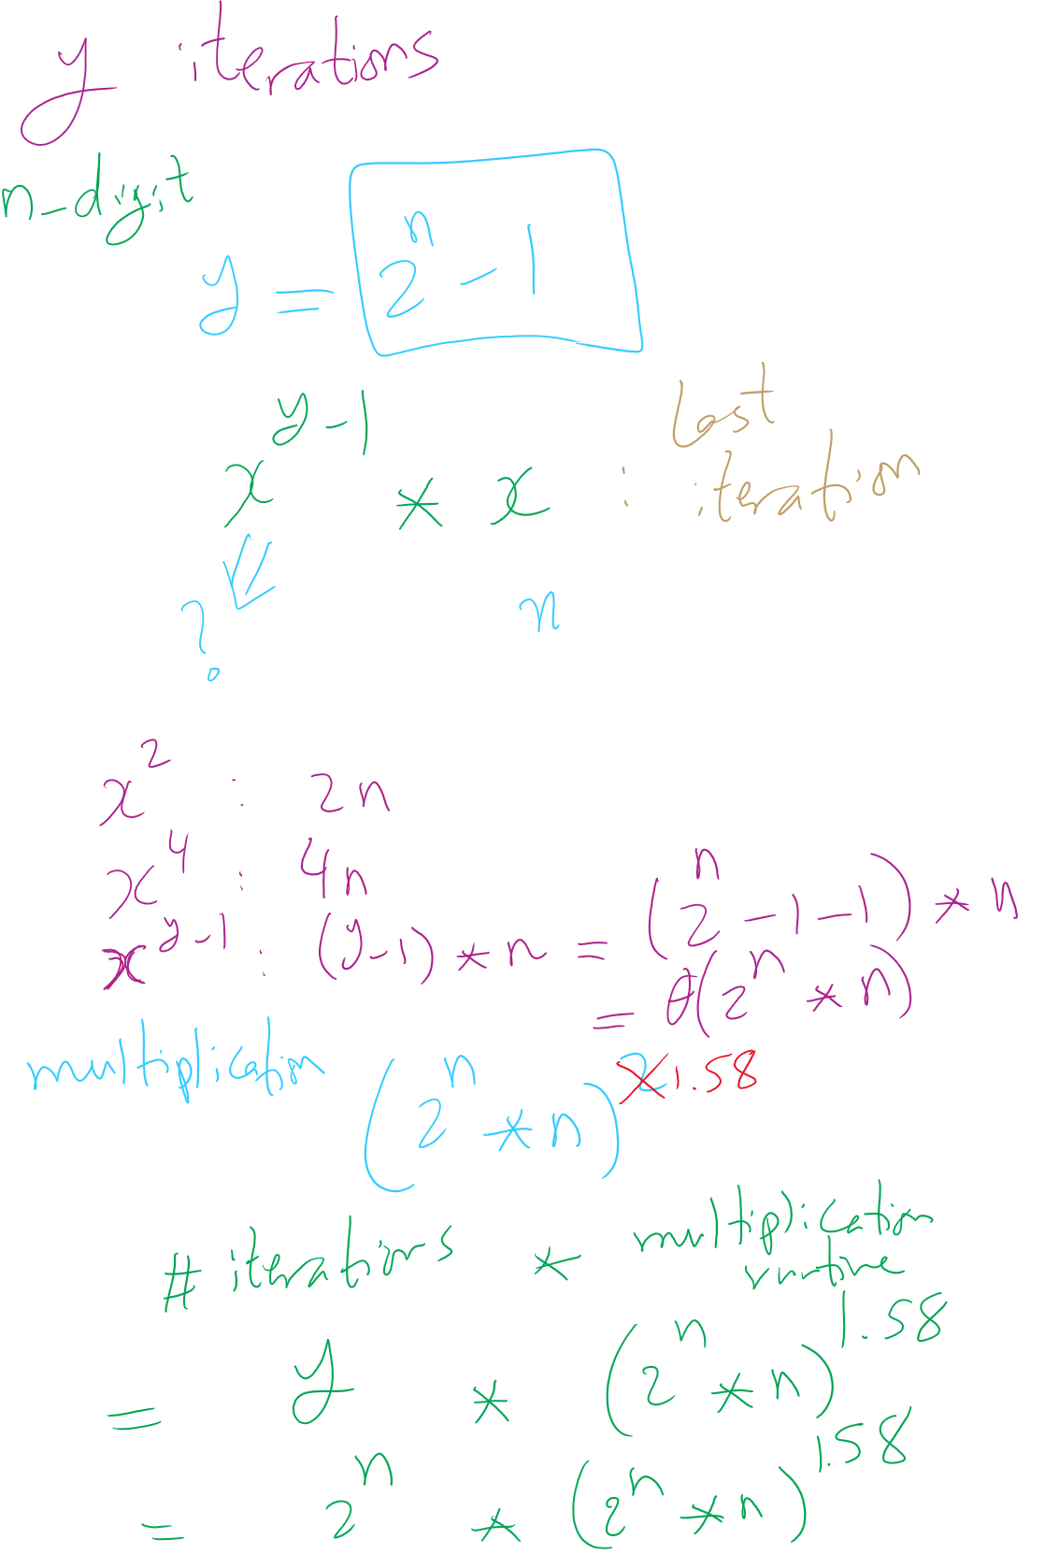
Runtime Analysis

Slide 11
This is RIDICULOUSLY BAD
Assuming 512 bit operands, 2⁵¹²:
13407807929942597099574024998205846127479365820592393377723561443721764030073546976801874298166903427690031858186486050853753882811946569946433649006084096
Assuming we can do mults in 1 cycle…
Which we can’t as we learned last lecture
And further that these operations are completely parallelizable
16 4GHz cores = 64,000,000,000 cycles/second
(2⁵¹² / 64000000000) / (3600 * 24 * 365) =
6.64 * 10¹³⁵ years to compute

Slide 12
This is way too long to do exponentiations!
So how do we do better?
Let’s try divide and conquer!
x^{y} = (x^{(y/2)})²
When y is even, (x^{(y/2)})² * x when y is odd
Analyzing a recursive approach:
Base case?
When y is 1, x^{y} is x; when y is 0, x^{y} is 1
Runtime?

Slide 13
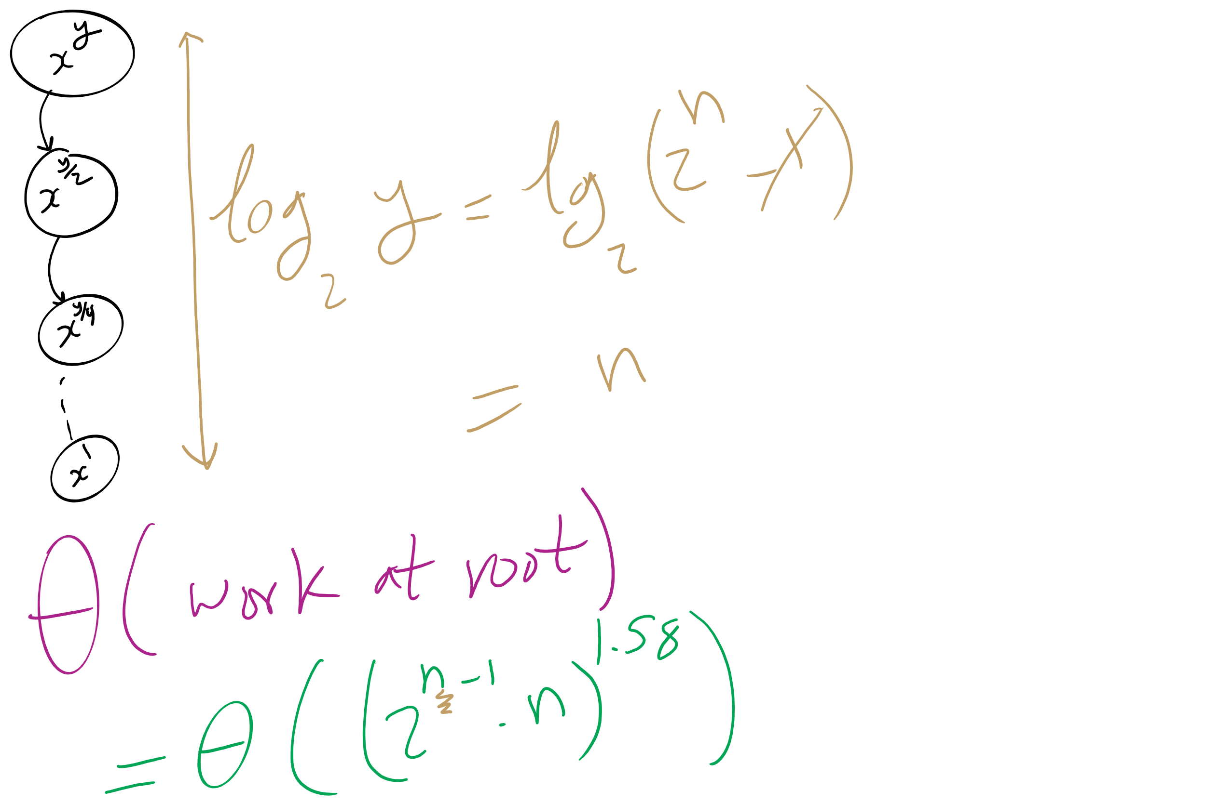
Runtime Analysis

Slide 14
But we need to do expensive mult in each call
We need to do Θ((2^{(n-1)} * n)²) work in just the root call!
Our runtime is dominated by multiplication time
Exponentiation quickly generates HUGE numbers
Time to multiply them quickly becomes impractical

Slide 15
Can we do better?
We go “top-down” in the recursive approach
Start with y
Halve y until we reach the base case
Square base case result
Continue combining until we arrive at the solution
What about a “bottom-up” approach?
Start with our base case
Operate on it until we reach a solution

Slide 16
A bottom-up approach
To calculate x^{y}
ans = 1
foreach bit in y:
ans = ans²
if bit == 1:
ans = ans * x
From most to least significant

Slide 17
Bottom-up exponentiation example
Consider x^{y} where y is 43 (computing x⁴³)
Iterate through the bits of y (43 in binary: 101011)
ans = 1
ans = 1² = 1
ans = 1 * x = x
ans = x² = x²
ans = (x²)² = x⁴
ans = x⁴ * x = x⁵
ans = (x⁵)² = x¹⁰
ans = (x¹⁰)² = x²⁰
ans = x²⁰ * x = x²¹
ans = (x²¹)² = x⁴²
ans = x⁴² * x = x⁴³
Notes:
3⁴³ = 328256967394537077627

Slide 18
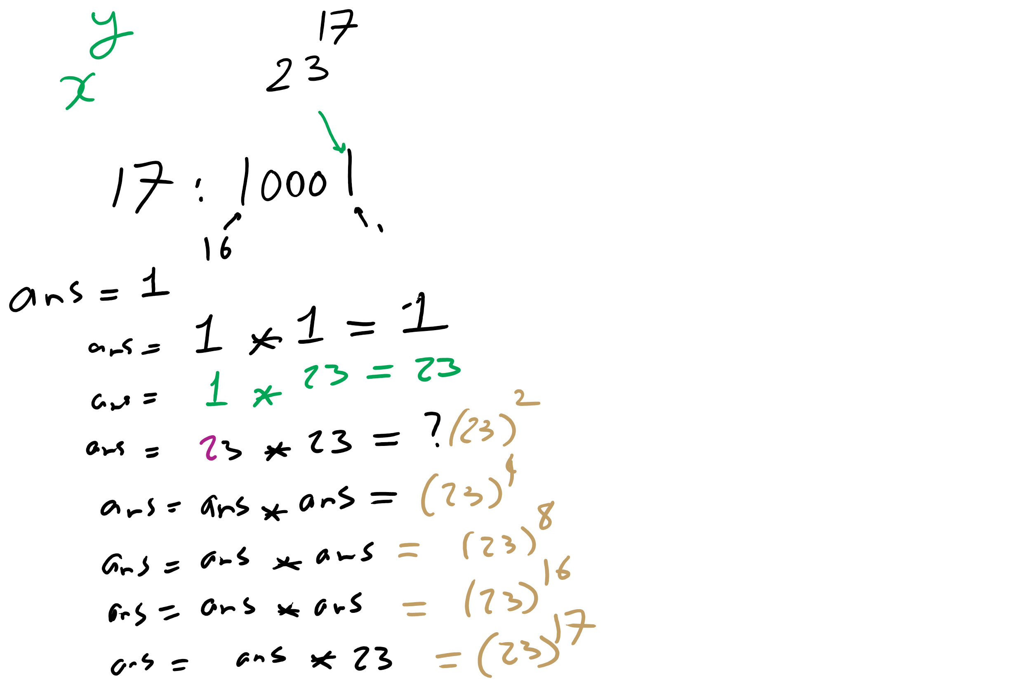
Bottom-up Exponentiation Example 1

Slide 19
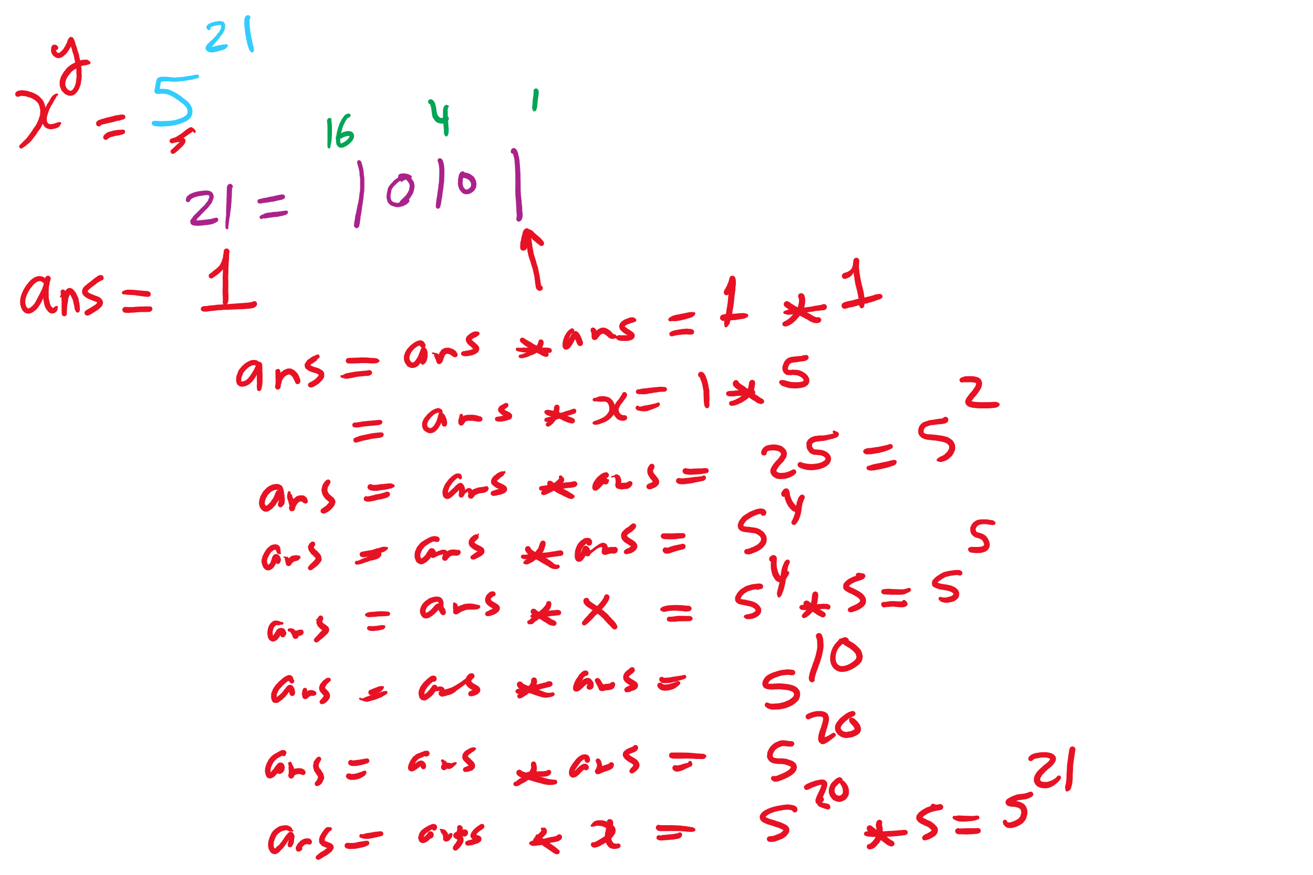
Bottom-up Exponentiation Example 2

Slide 20
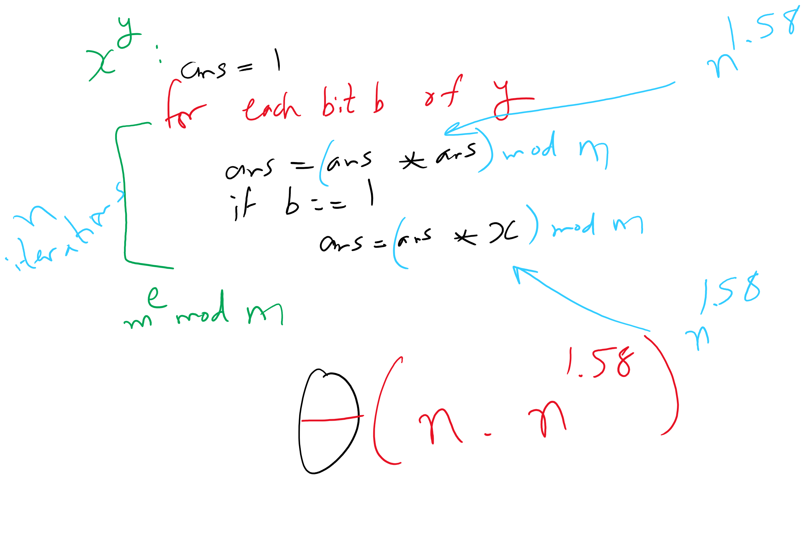
Bottom-up Exponentiation
2
2
2

Slide 21
Does this solve our problem with mult times?
Nope, still squaring ans everytime
We’ll have to live with huge output sizes
This does, however, save us recursive call overhead
Practical savings in runtime

Slide 22
Efficient exponentiation for RSA
Does this solve our problems?
ans = 1
foreach bit in y:
ans = (ans² mod n)
if bit == 1:
ans = (ans * x mod n)
ans = 1
foreach bit in y:
ans = ans²
if bit == 1:
ans = ans * x
How can we improve runtime for RSA exponentiations?
Don’t actually need x^{y}
Just need (x^{y} mod n)

Slide 23
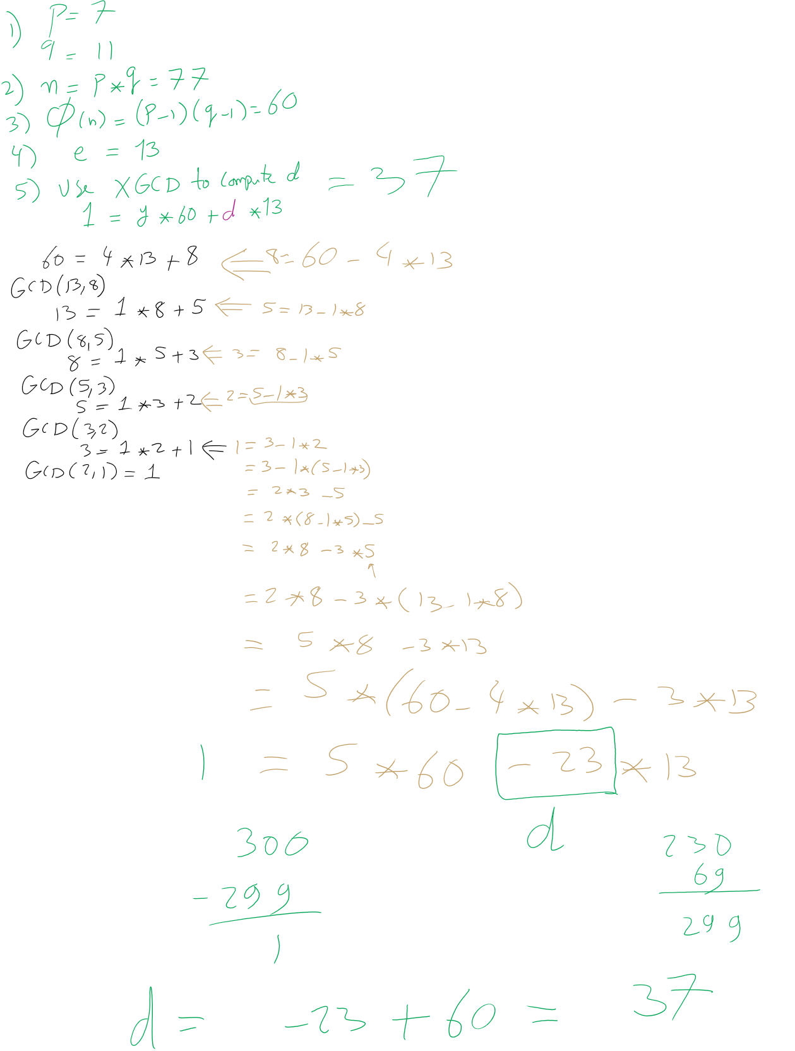
RSA Example 1

Slide 24
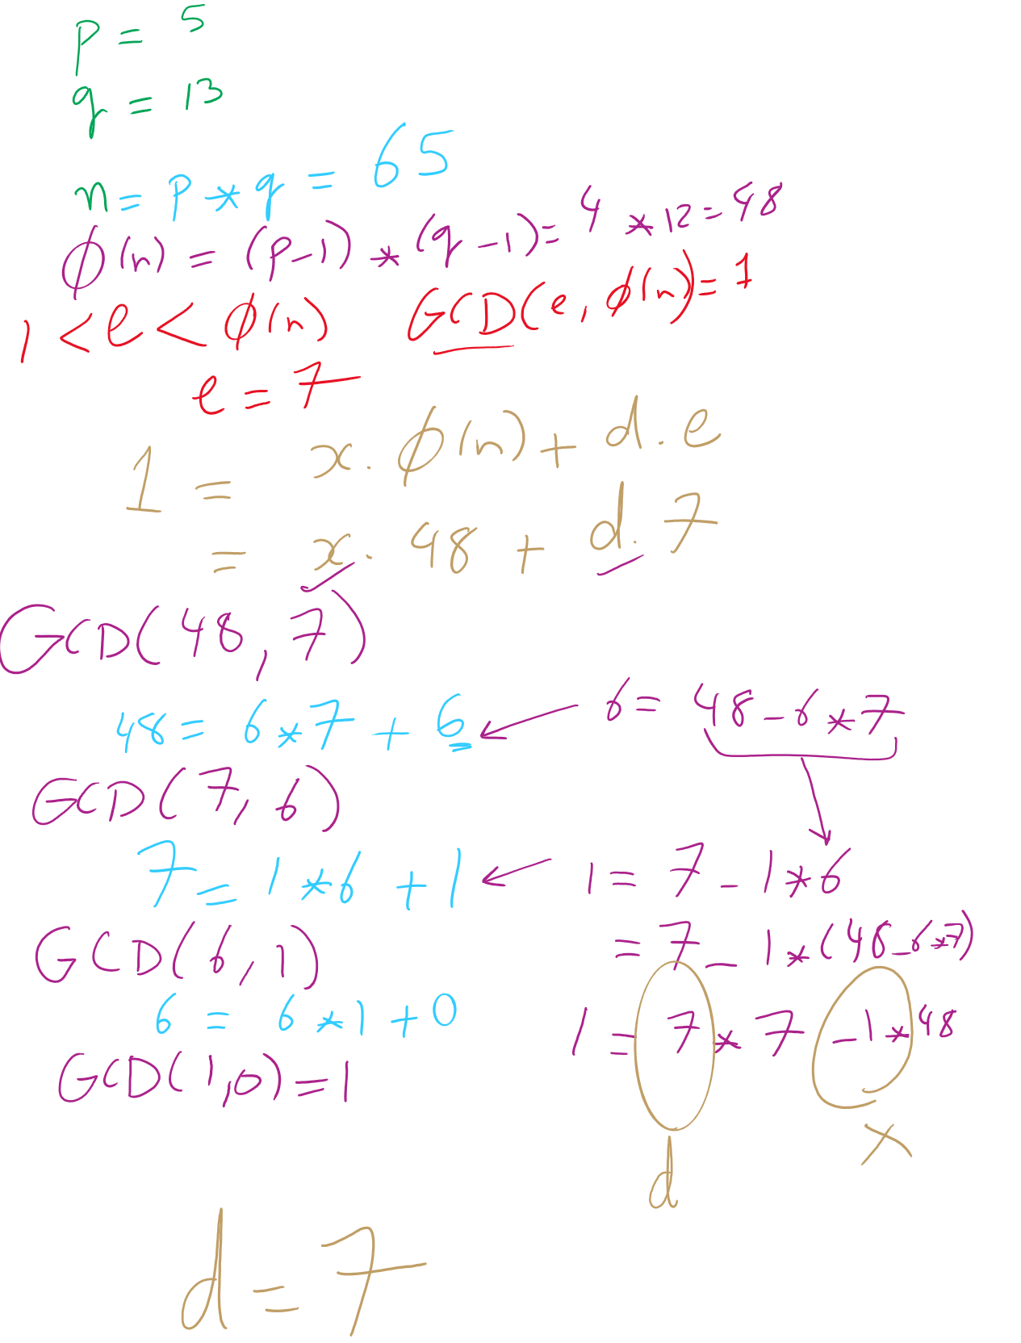
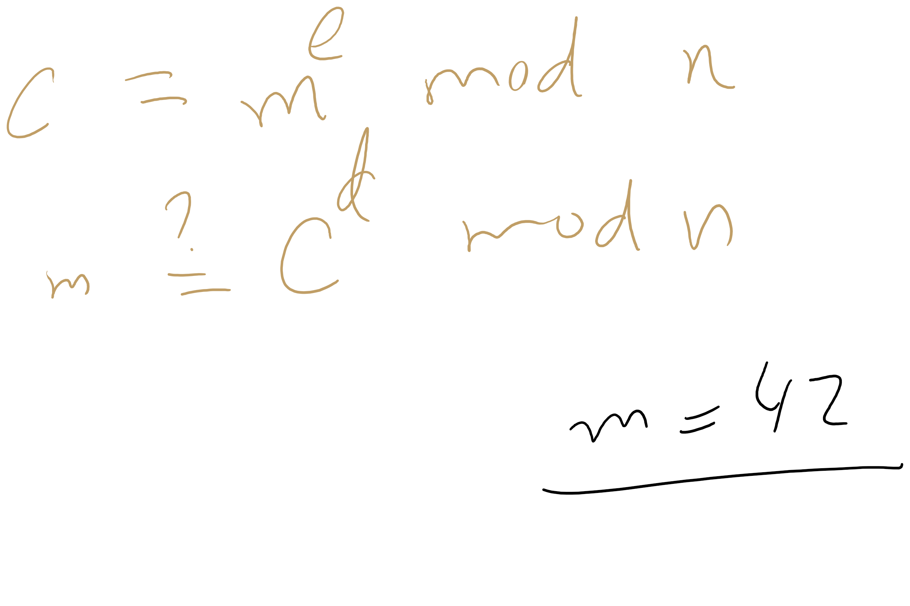
RSA Example 2

Slide 25
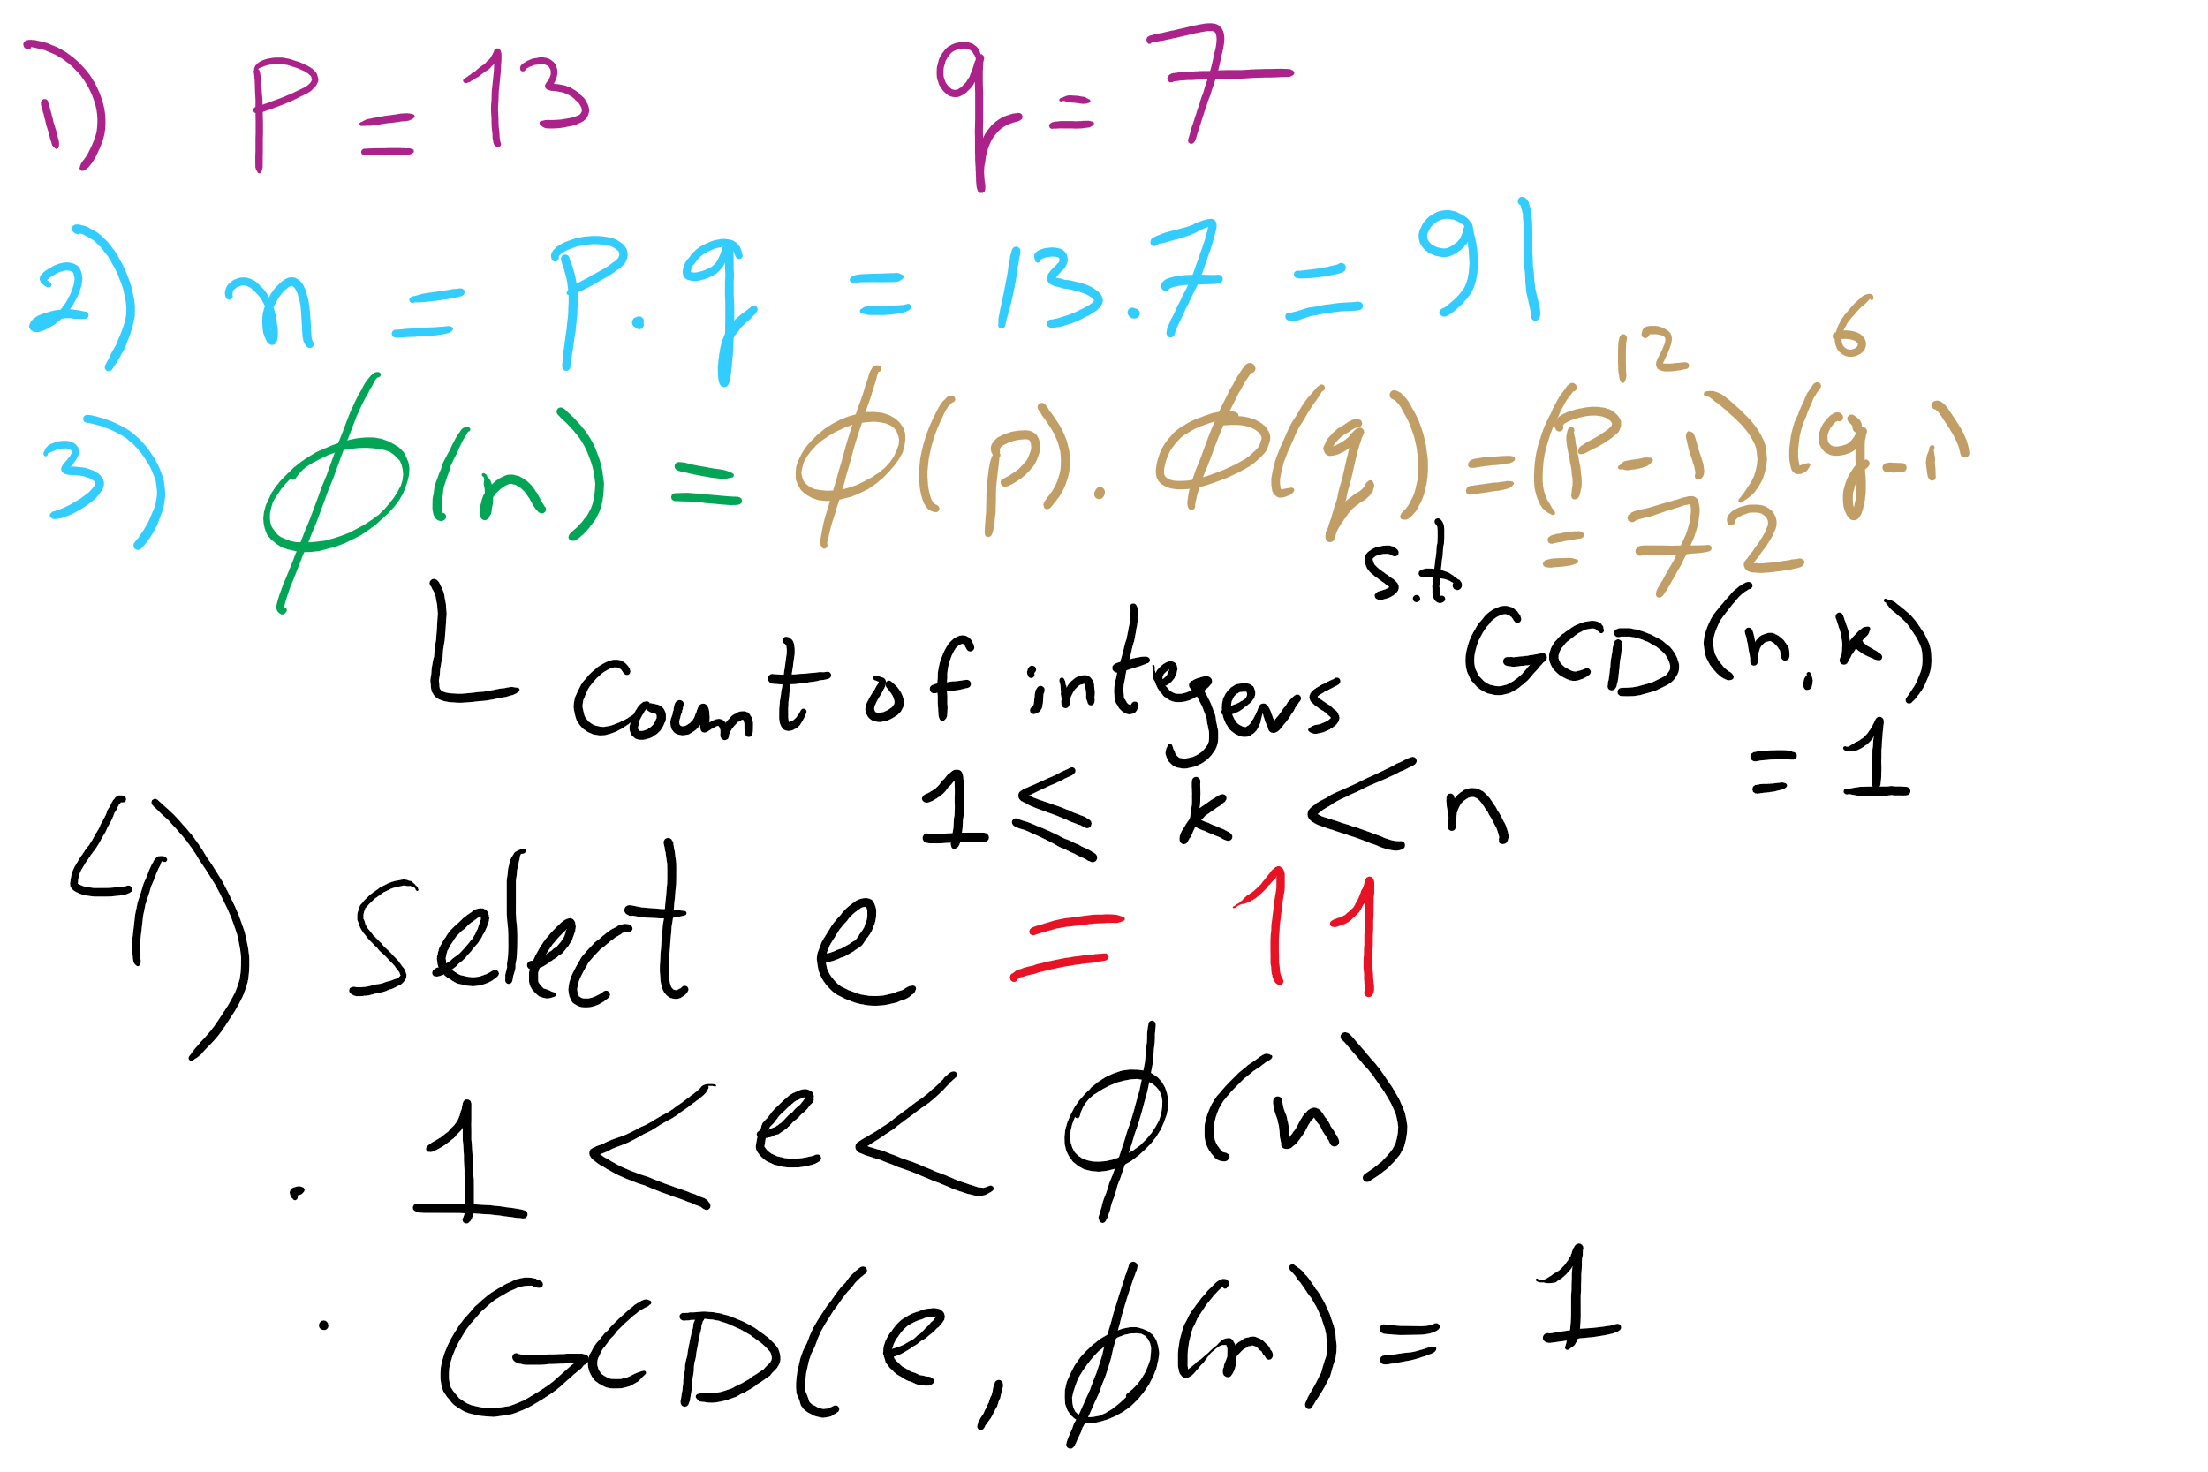
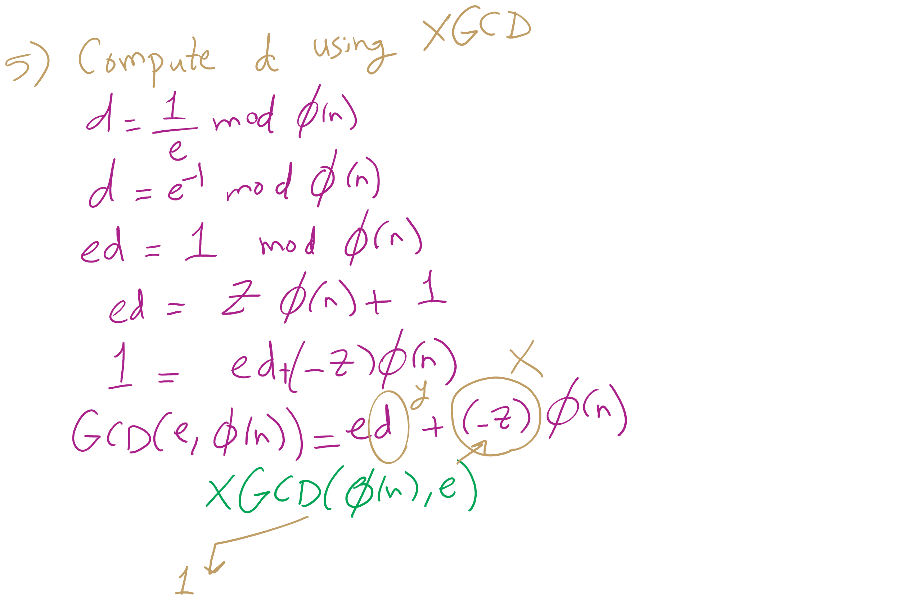
RSA Example 3

Slide 26
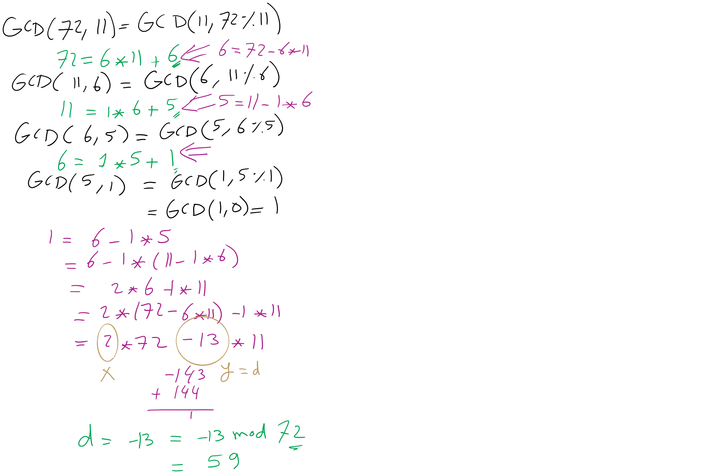
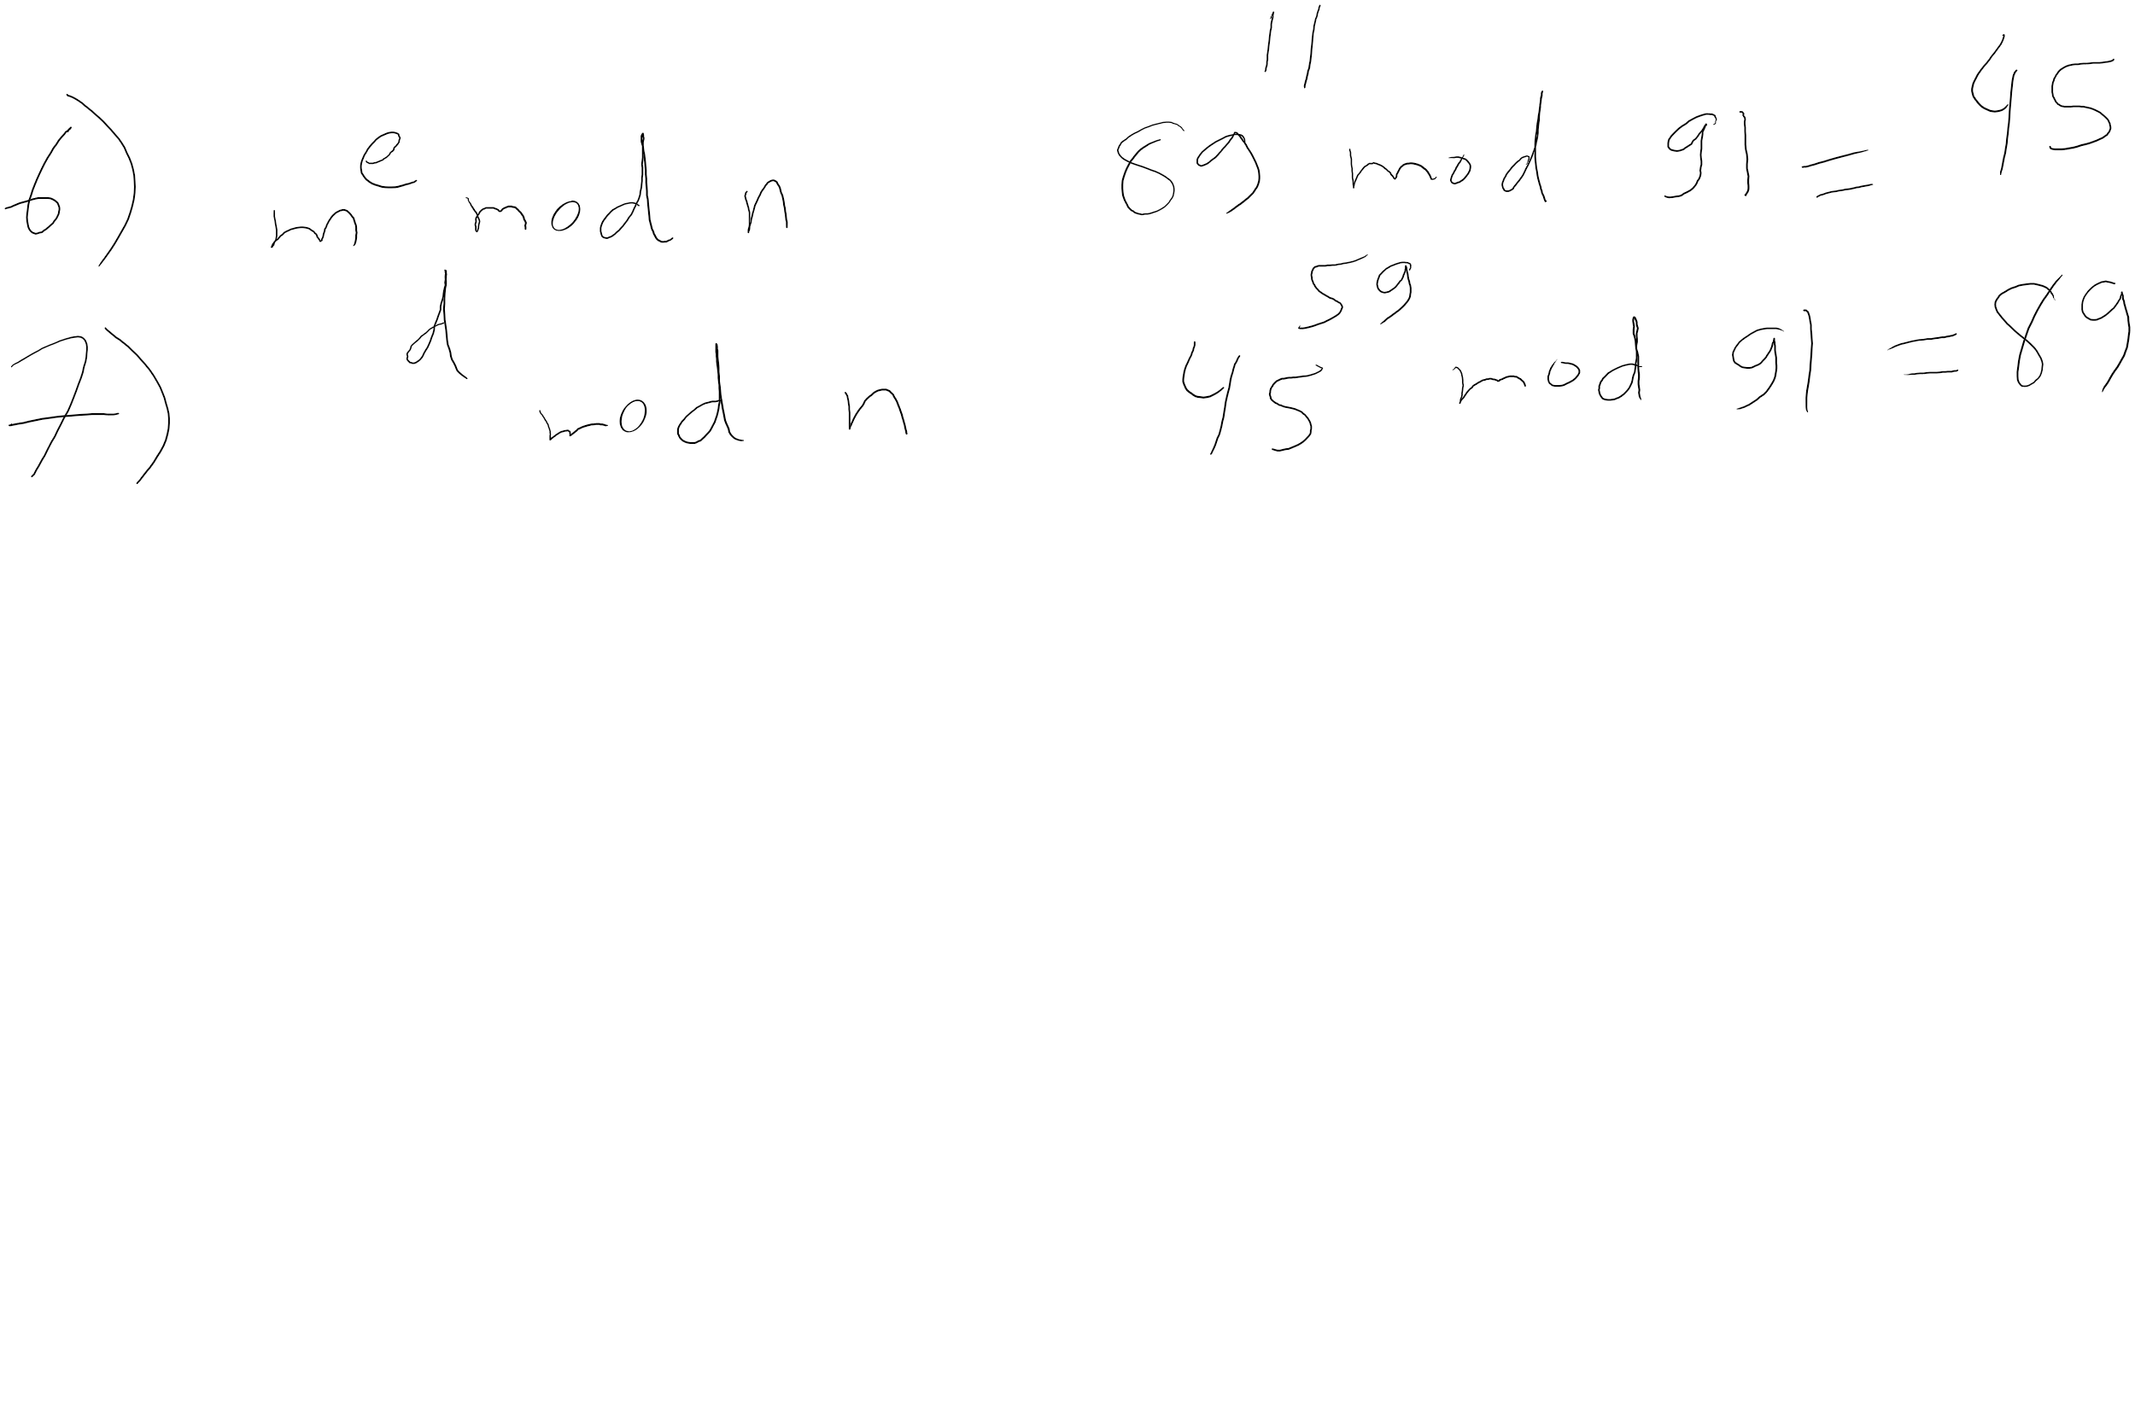
RSA Example 3 (contd.)

Slide 27
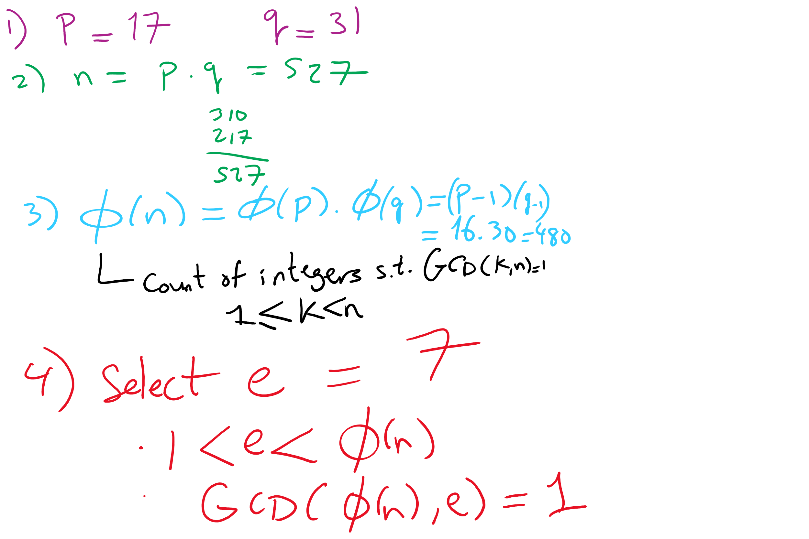
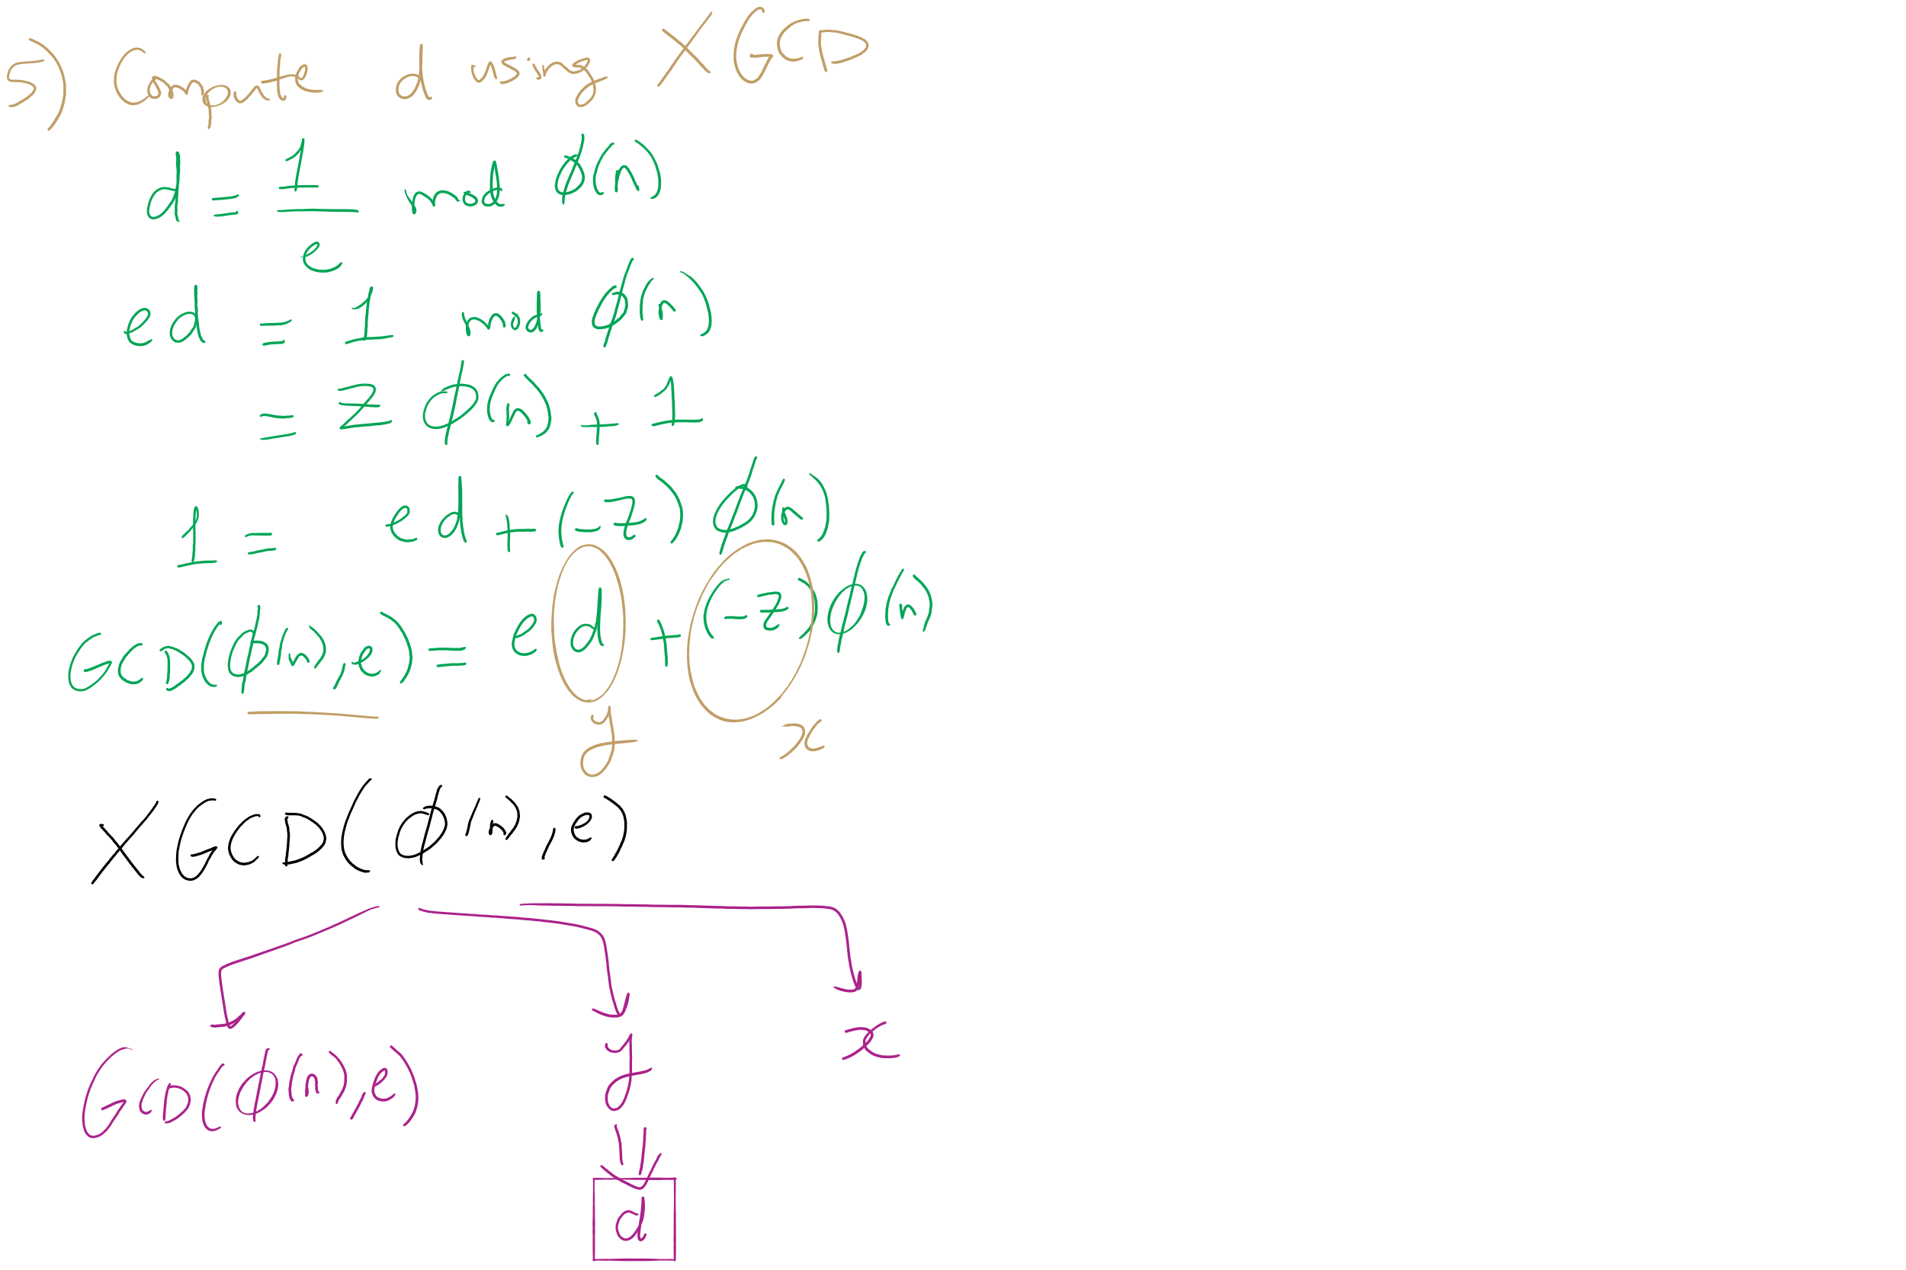
RSA Example 4

Slide 28
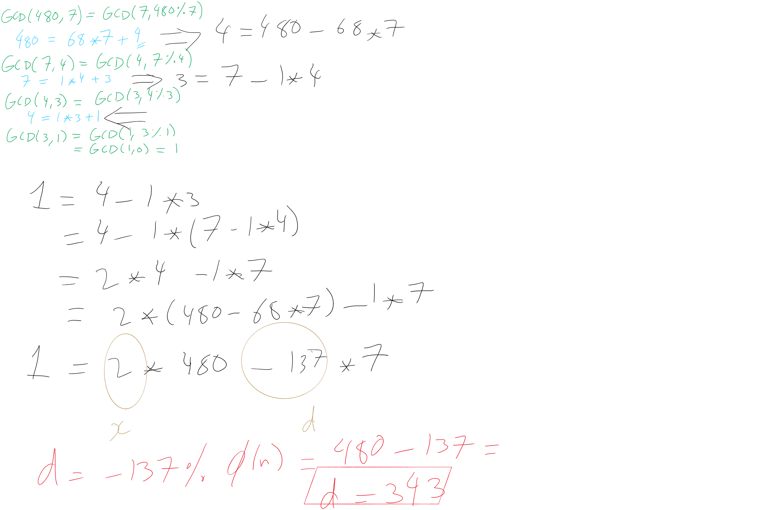
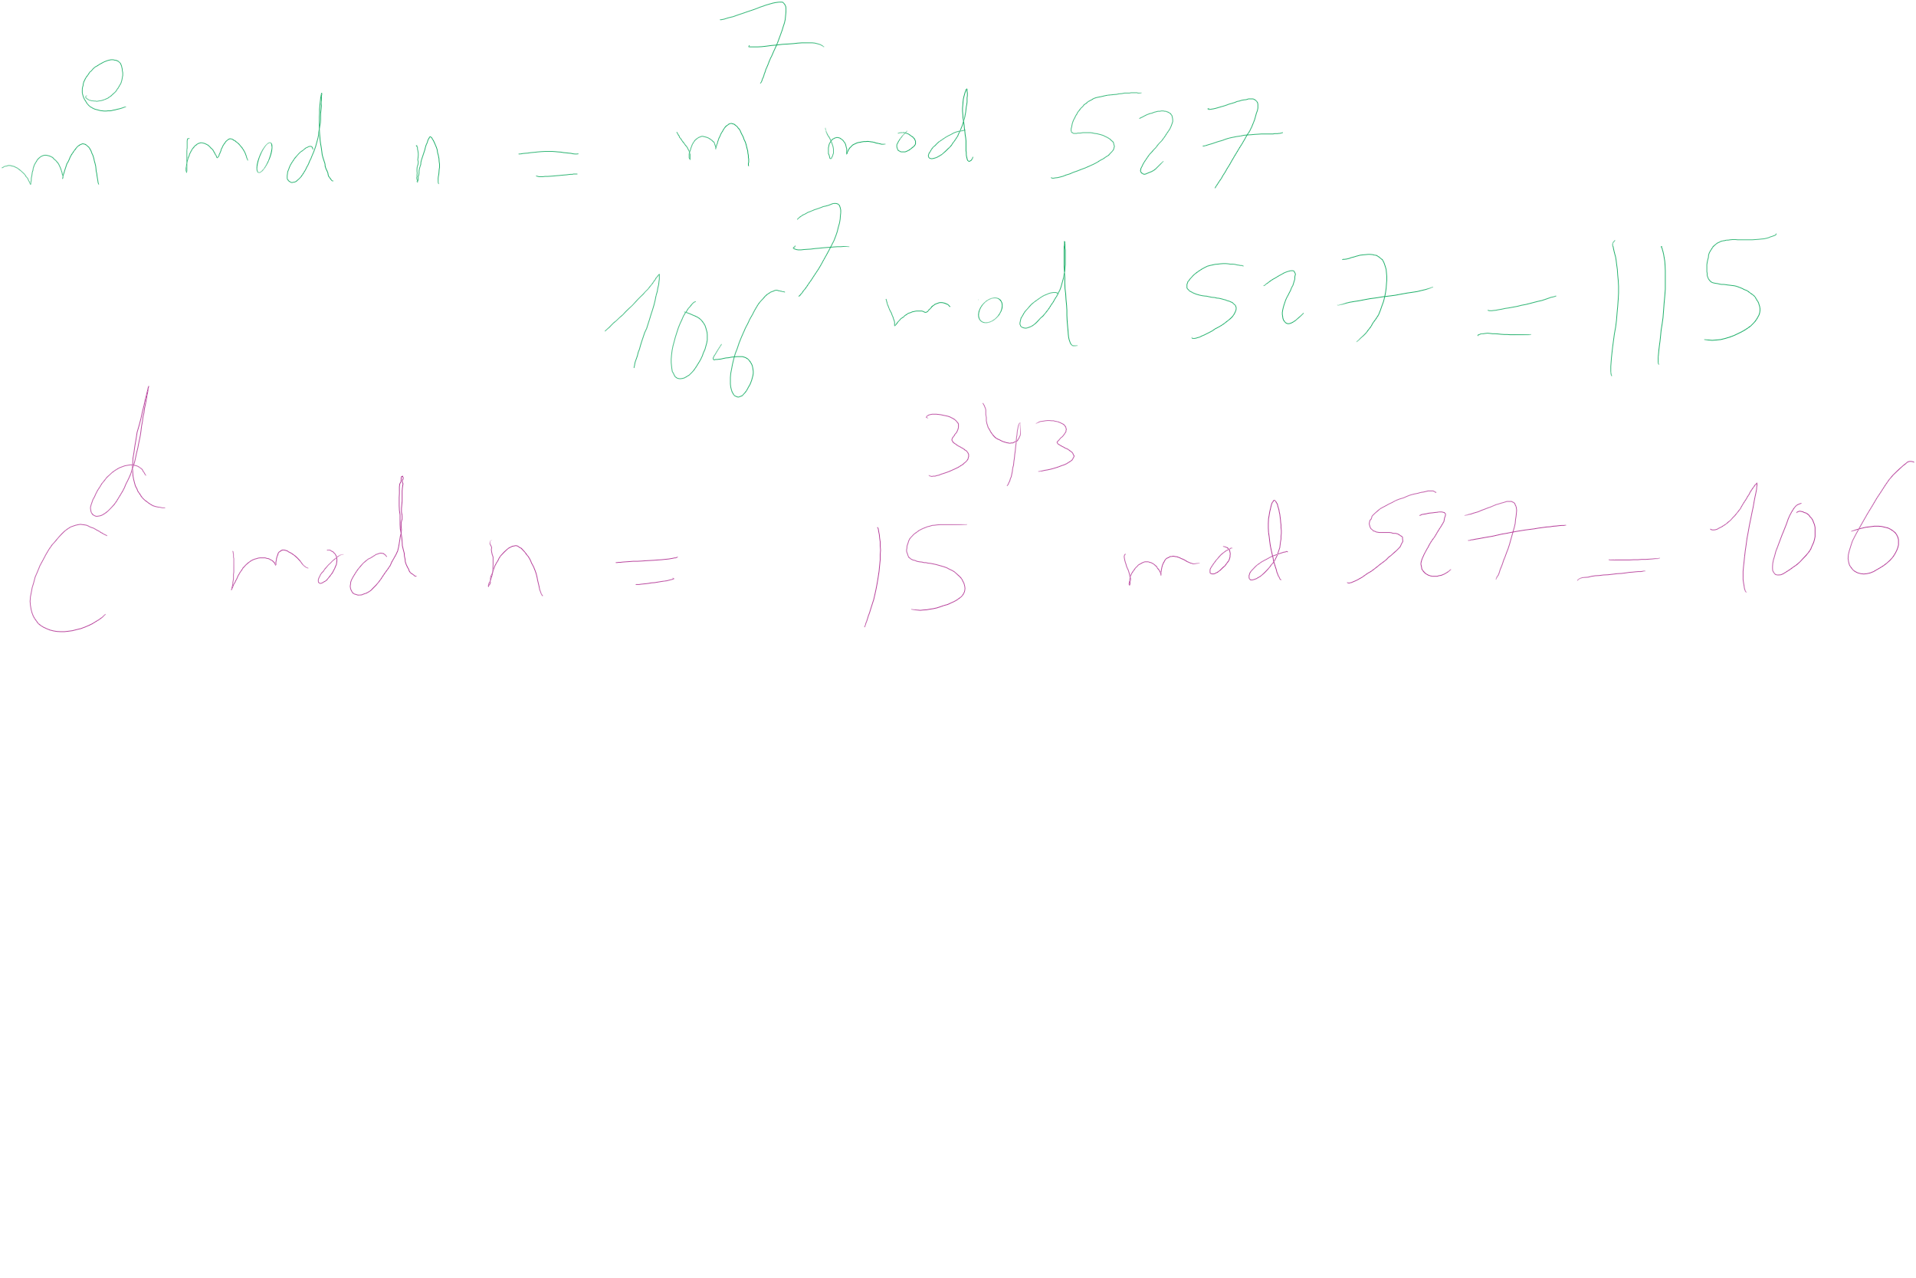
RSA Example 4 (contd.)

Slide 29
OK, but how does m^{ed} = m mod n?
Feel free to look up the proof using Fermat’s little theorem
Knowing this proof is NOT required for the course
Knowing how to generate RSA keys and encrypt/decrypt IS
For this course, we’ll settle with our example showing that it does work

Slide 30
Why is RSA secure?
4 avenues of attack on the math of RSA were identified in the original paper:
Factoring n to find p and q
Determining φ(n) without factoring n
Determining d without factoring n or learning φ(n)
Learning to take e^{th} roots modulo n

Slide 31
Factoring n
To the best of our knowledge, this is hard
A 768 bit RSA key was factored one time using the best currently known algorithm
Took 1500 CPU years
2 years of real time on hundreds of computers
Hence, large keys are pretty safe
2048 bit keys are a pretty good bet for now

Slide 32
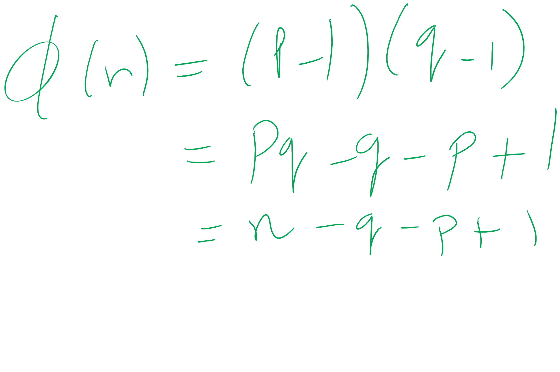
What about determining φ(n) without factoring n?
Would allow us to easily compute d because ed = 1 mod φ(n)
Note:
φ(n) = n - p - q + 1
φ(n) = n - (p + q) + 1
(p + q) = n + 1- φ(n)
(p + q) - (p - q) = 2q
Now we just need (p - q)...
(p - q)² = p² - 2pq + q²
(p - q)² = p² + 2pq + q² - 4pq
(p - q)² = (p + q)² - 4pq
(p - q)² = (p + q)² - 4n
(p - q) = √((p + q)² - 4n)
If we can figure out φ(n) efficiently, we could factor n efficiently!

Slide 33
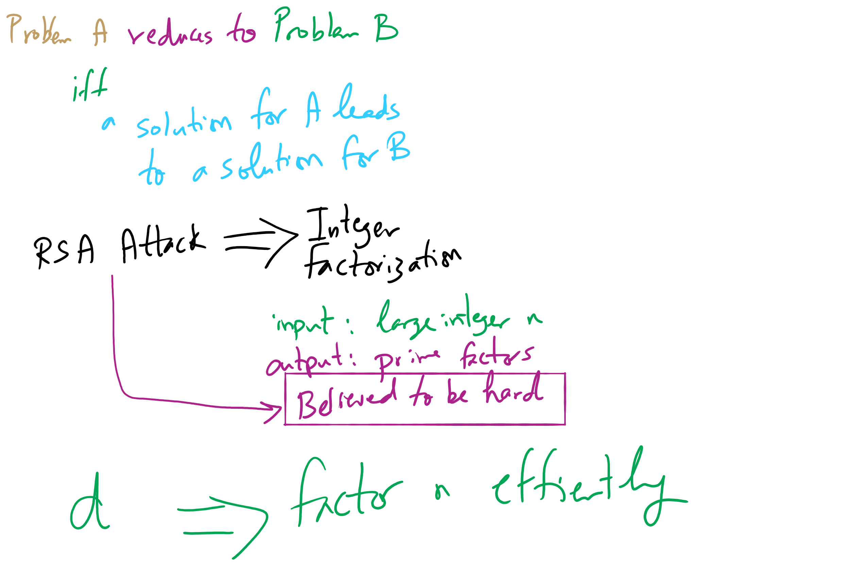
Reduction and RSA Security

Slide 34
Determining d without factoring n or learning φ(n)?
If we know, d, we can get a multiple of φ(n)
ed = 1 mod φ(n)
ed = kφ(n) + 1
For some k
ed - 1 = kφ(n)
It has been shown that n can be efficiently factored using any multiple of φ(n)
Hence, this would provide another efficient solution to factoring!

Slide 35
Learning to take e^{th} roots modulo n
Conjecture was made in 1978 that breaking RSA would yield an efficient factoring algorithm
To date, it has been not been proven or disproven

Slide 36
This all leads to the following conclusion
Odds are that breaking RSA efficiently implies that factoring can be done efficiently.
Since factoring is probably hard, RSA is probably safe to use.

Slide 37
RSA Implementation concerns
Encryption/decryption:
How can we perform efficient exponentiations?
Key generation:
We can do multiplication, XGCD for large integers
What about finding large prime numbers?

Slide 38
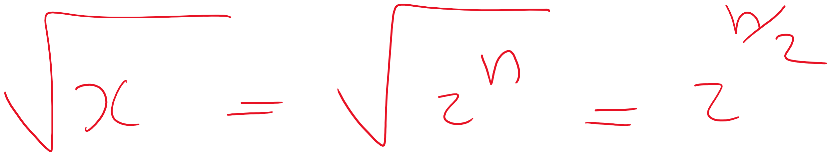
Prime testing option 1: BRUTE FORCE
Try all possible factors of x
1 .. sqrt(x)
aka 1 .. sqrt(2^{size(x)})
For a total of 2^{(size(x)/2)} factor checks
A factor check should take about the same amount of time as multiplication
size(x)²
So our runtime is Θ(2^{(size(x)/2)} * size(x)²)

Slide 39
Option 2: A probabilistic approach
Need a method test : Z×Z → {T, F}
If test(x, a) = F, x is composite based on the witness a
If test(x, a) = T, x is probably prime based on the witness a
To test a number x for primality:
Randomly choose a witness a
if test(x, a) = F, x is composite
if test(x, a) = T, loop
Possible implementations of test(x, a):
Miller-Rabin, Fermat’s, Solovay–Strassen
often probability ≈ 1/2
k repetitions leads to probability that x is composite ≈ 1/2^{k}

Slide 40
RSA still slower (generally) than symmetric encryption
If only we could have the speed of symmetric encryption without the key distribution woes!
What if we transmitted symmetric crypto keys with RSA?
RSA Envelopes!
Going back to Alice and Bob
Alice generates a random AES key
Alice encrypts her message using AES with this key
Alice encrypts the key using Bob’s RSA public key
Alice sends the encrypted message and encrypted key to Bob
Bob decrypts the AES key using his RSA private key
Bob decrypts the message using the AES key

Slide 41


RSA Envelope example
KEY_{AES} = rand.nextInt(0, 2²⁵⁶)
KEY_{AES}
KEY_{AES}
SECRET MESSAGE
SECRET MESSAGE
BOB_{PUB}
BOB_{PRIV}
KEY_{AES}
BOB_{PUB}
KEY_{AES}

Slide 42
Another fun use of RSA...
Notice that encrypting and decrypting are inverses
m^{ed} = m^{de} (mod n)
We can “decrypt” the message first with a private key
Then recover the message by “encrypting” with a public key
Note that anyone can recover the message
However, they know the message must have come from the owner of the private key
Using RSA this way creates a digital signature

Slide 43
Do RSA signatures need to be slow?
We encrypted symmetric crypto keys before to speed things up…
We'll need another crypto primitive to help out here
Cryptographically secure hash functions

Slide 44
Hashing for security (similarities)
Cryptographically secure hash functions share properties with the hash functions we've already talked about in recitations:
Map from some input domain to a limited output range
Though output ranges are much larger here
For modern algorithms 224-512 bit output sizes
Time required to compute the hash is proportional to the size of the item being hashed
Though, practically, cryptographic hash functions are more expensive
Notes:
Discuss use of crypto hashing to implement a hash table

Slide 45
Now just sign a hash of the message!
H_{BOB} = h
MSG. DEF. FROM BOB
H_{ALICE} = h
MSG. DEF. FROM BOB
Same?
MSG. DEF. FROM BOB
MSG. DEF. FROM BOB
BOB_{PRIV}
BOB_{PUB}
H_{BOB}
BOB_{PRIV}
H_{BOB}

Slide 46
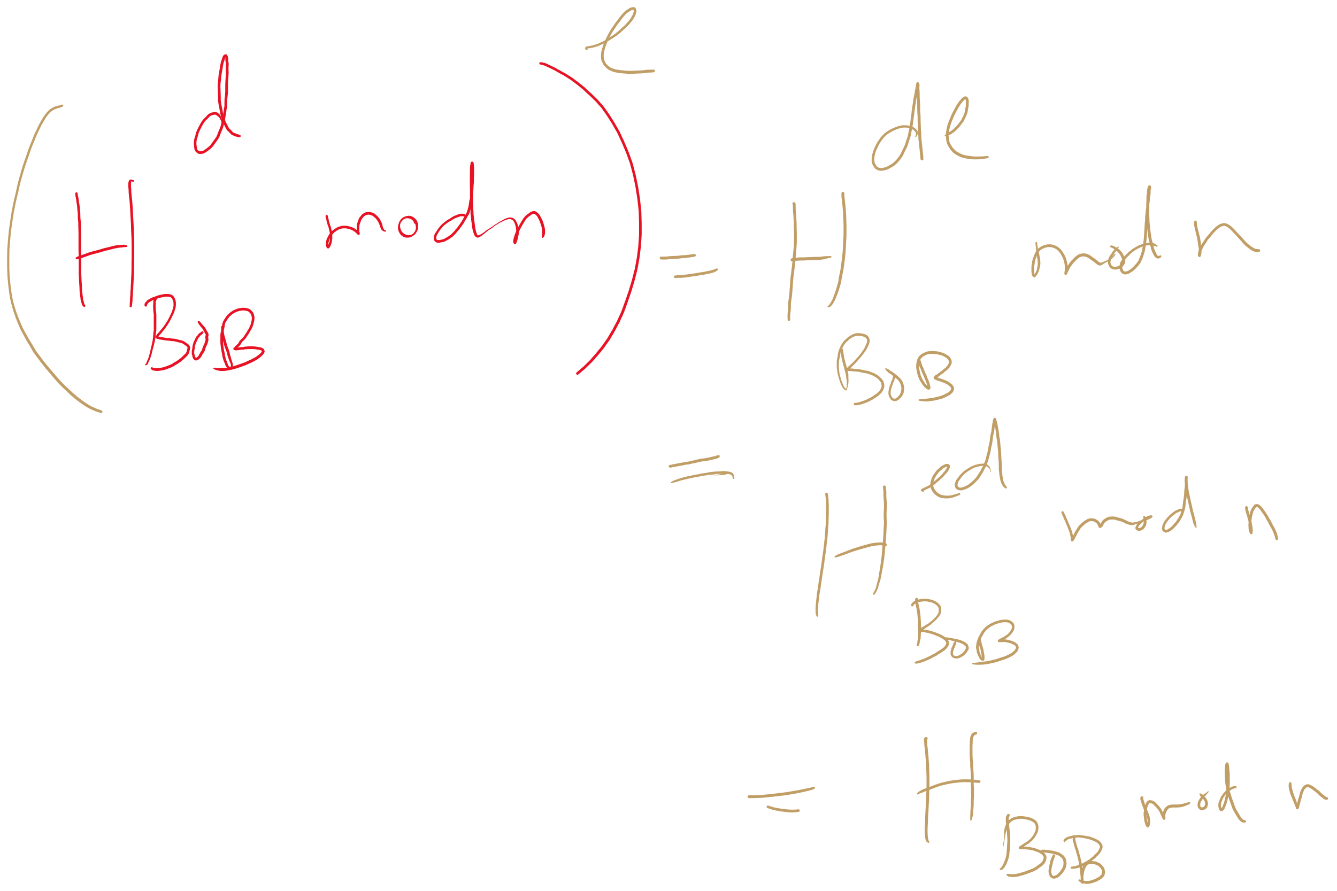
Why does it work?

Slide 47
What about collisions?
If Bob signs a hash of the message “I’ll see you at 7”
It could appear that Bob signed any message whose hash collides with “I’ll see you at 7”...
If h(“I’ll see you at 7”) == h(“I’ll see you after I rob the bank”), Bob could be in alot of trouble
An attack like this helped the Flame malware to spread
This is also the reason Google is aiming to deprecate SHA-1
Notes:
Discuss using modular hashing for digital signatures

Slide 48
Hashing for security (differences)
This is why cryptographically secure hash functions must support additional properties:
It should be infeasible to find two different messages with the same hash value
It should be infeasible to recover a message from its hash
Should require a brute force approach
Small changes to a message should change the hash value so extensively that the new hash value appears uncorrelated with the old hash value

Slide 49
Public key isn’t perfect
What do you do when a private key is compromised?

Slide 50
Final note about crypto
NEVER IMPLEMENT YOUR OWN CRYPTO
Use a trusted and tested library.

Slide 51
Master Method
How can we analyze the runtime of a recursive algorithm?
Master Method!

Slide 52
So what's the runtime???
Recursion really complicates our analysis…
We’ll use a recurrence relation to analyze the recursive runtime
Goal is to determine:
How much work is done in the current recursive call?
How much work is passed on to future recursive calls?
All in terms of input size

Slide 53
Recurrence relation for divide and conquer multiplication
Assuming we cut integers exactly in half at each call
I.e., input bit lengths are a power of 2
Work in the current call:
Shifts and additions are Θ(n)
Work left to future calls:
4 more multiplications on half of the input size
T(n) = 4T(n/2) + Θ(n)

Slide 54
Soooo… what’s the runtime?
Need to solve the recurrence relation
Remove the recursive component and express it purely in terms of n
A “cookbook” approach to solving recurrence relations:
The master theorem

Slide 55
The master theorem
Usable on recurrence relations of the following form:
T(n) = aT(n/b) + f(n)
Where:
a is a constant >= 1
b is a constant > 1
and f(n) is an asymptotically positive function
Notes:
Note this does NOT cover nearly all possible recurrence relations, just really handy for alot of them
We will need more different techniques for more problematic recurrences

Slide 56
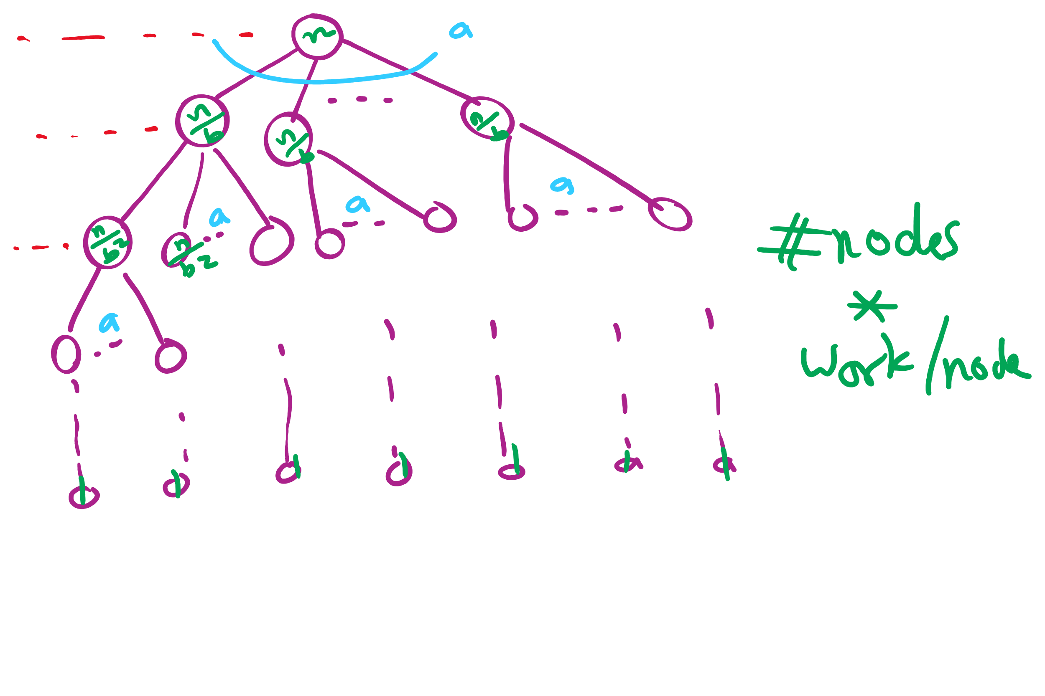
Recursion Tree

Slide 57
Applying the master theorem
T(n) = aT(n/b) + f(n)
If f(n) is O(n^{log_b(a) - ε}):
T(n) is Θ(n^{log_b(a)})
If f(n) is Θ(n^{log_b(a)})
T(n) is Θ(n^{log_b(a)} lg n)
If f(n) is Ω(n^{log_b(a) + ε}) and (a * f(n/b) <= c * f(n)) for some c < 1:
T(n) is Θ(f(n))
Notes:
T(n) = 2T(n/2) + n lg n
falls into a gap
n lg n is asymptotically larger than n, but not polynomially larger

Slide 58
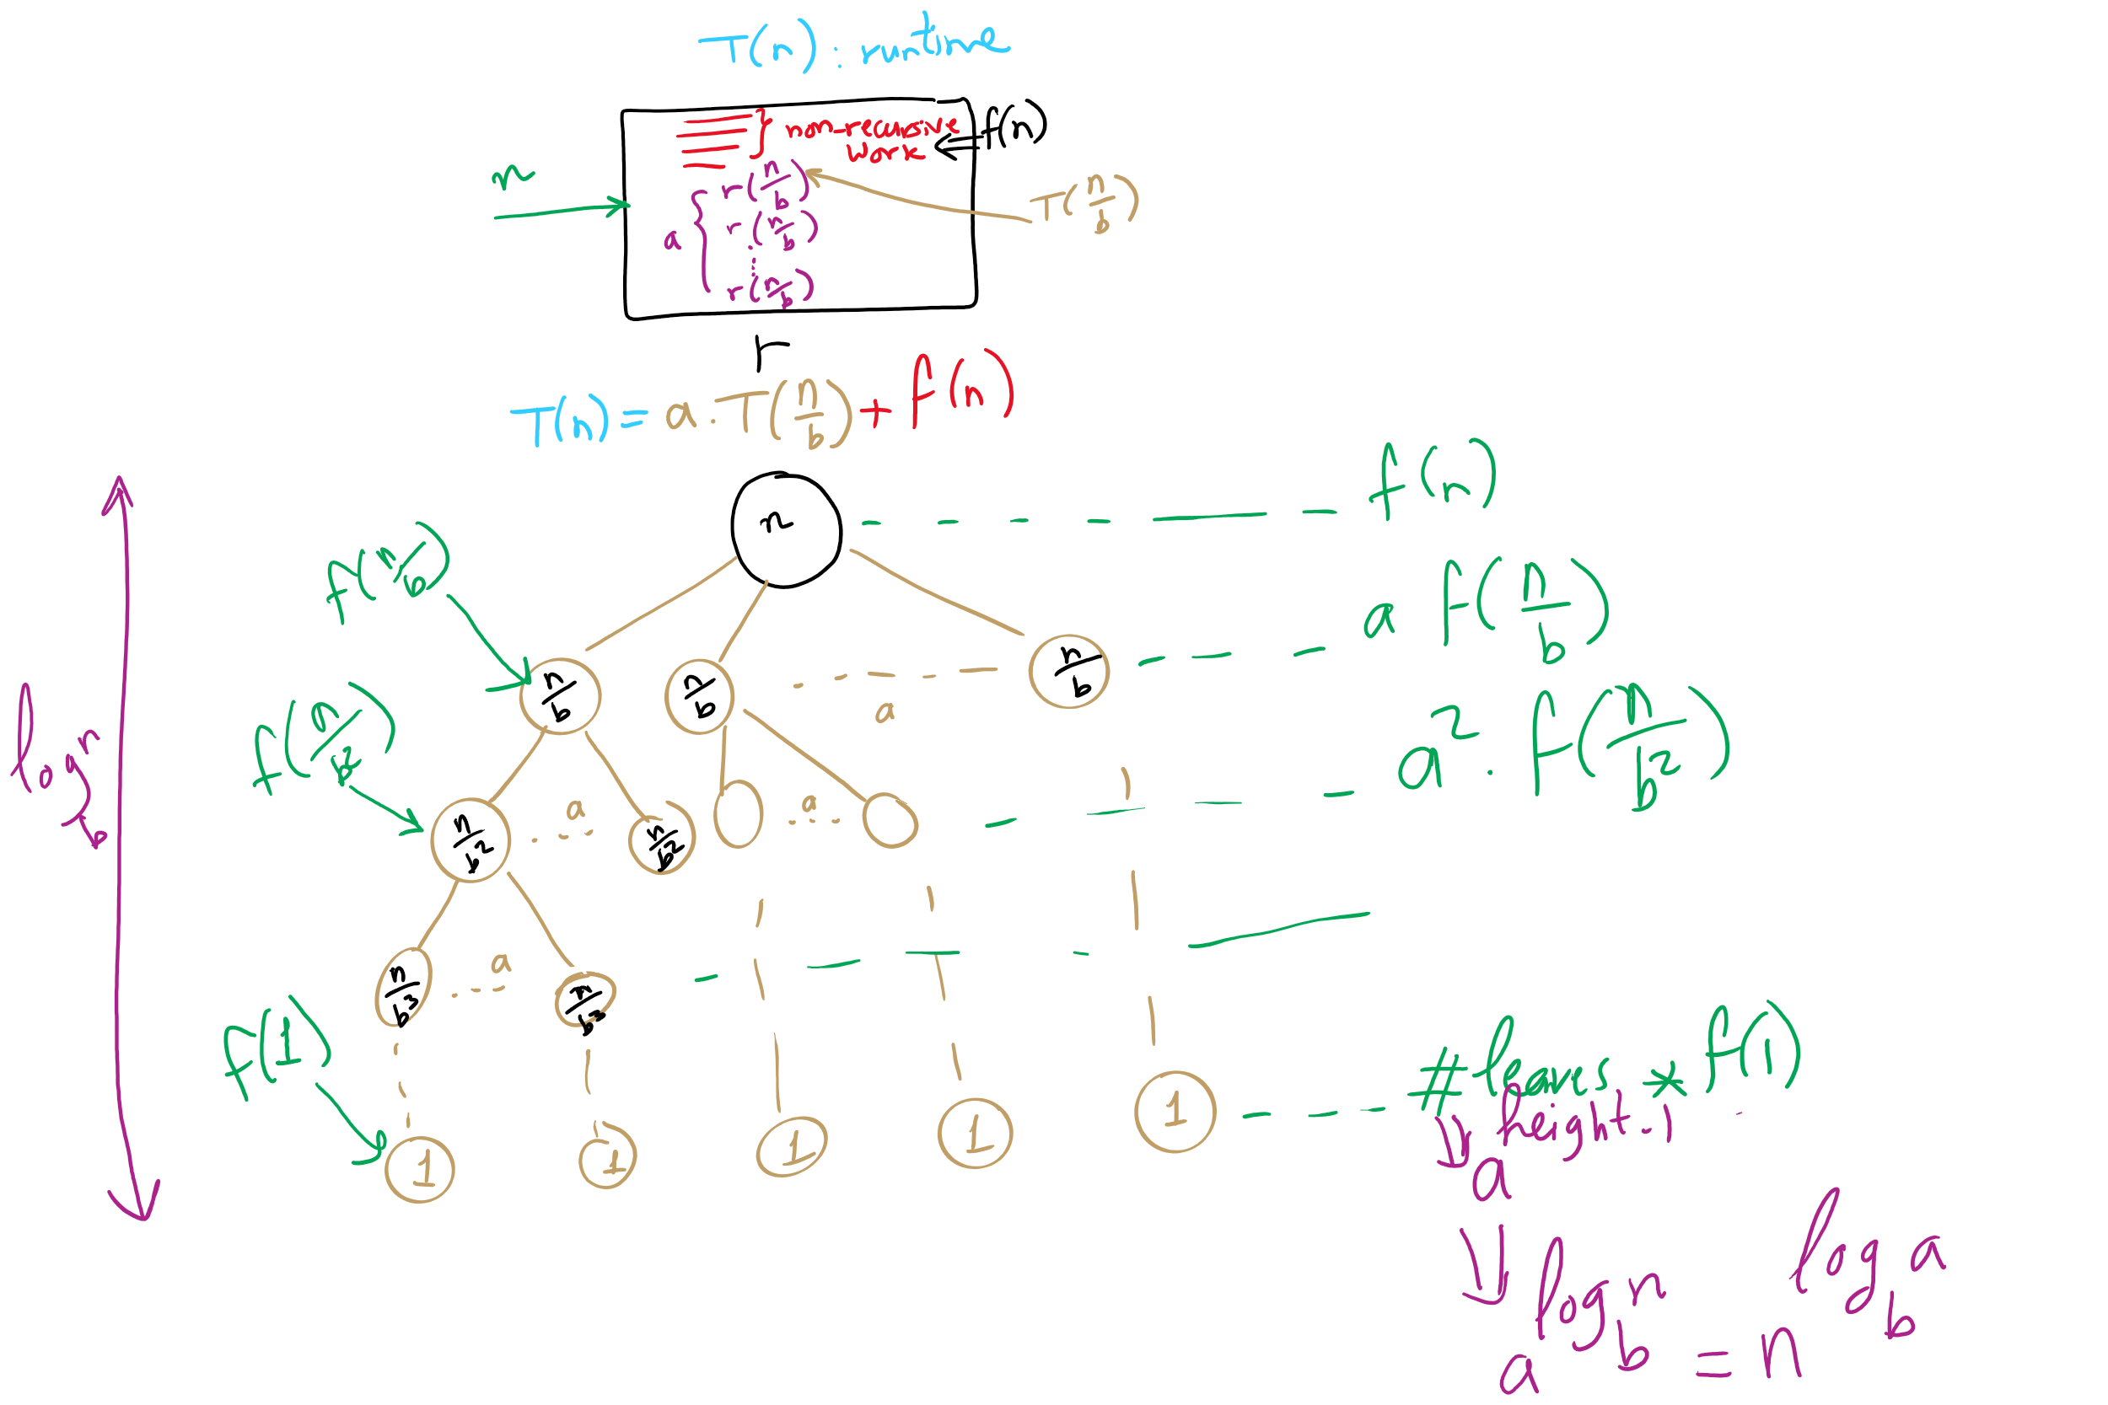
Recurrence vs. Recursion Tree

Slide 59
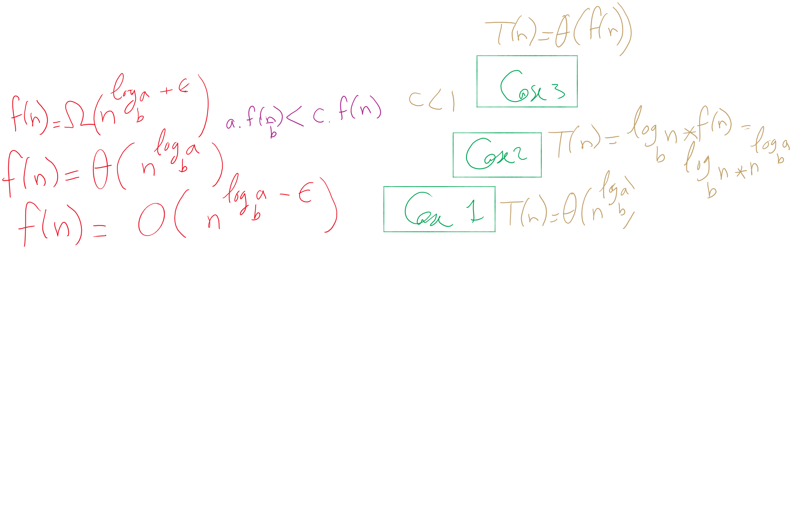


The 3 cases of the Master Theorem

Slide 60
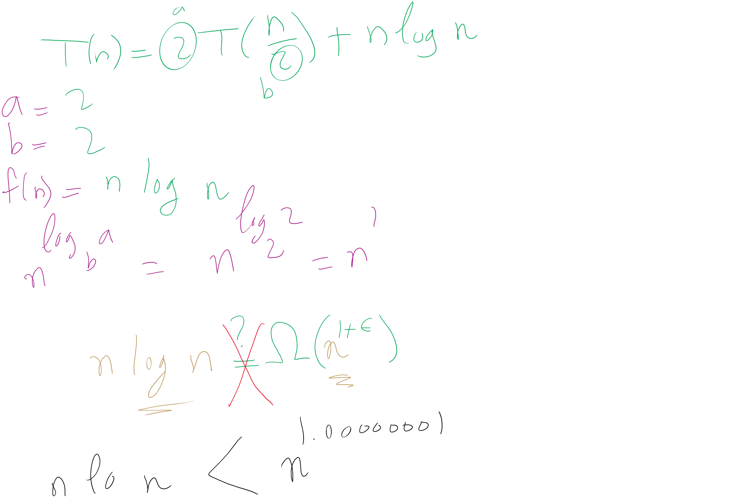
When Master Theorem doesn’t apply: Example

Slide 61
This Lecture
(Big)Integer Algorithms
Karatsuba multiplication
exponentiation
GCD
RSA encryption

Slide 62
Applying the master theorem
T(n) = aT(n/b) + f(n)
If f(n) is O(n^{log_b(a) - ε}):
T(n) is Θ(n^{log_b(a)})
If f(n) is Θ(n^{log_b(a)})
T(n) is Θ(n^{log_b(a)} lg n)
If f(n) is Ω(n^{log_b(a) + ε}) and (a * f(n/b) <= c * f(n)) for some c < 1:
T(n) is Θ(f(n))
Notes:
T(n) = 2T(n/2) + n lg n
falls into a gap
n lg n is asymptotically larger than n, but not polynomially larger

Slide 63
Mergesort master theorem analysis
Recurrence relation for mergesort?
T(n) = 2T(n/2) + Θ(n)
T(n) = 2T(n/2) + Θ(n)
If f(n) is O(n^{log_b(a) - ε}):
T(n) is Θ(n^{log_b(a)})
If f(n) is Θ(n^{log_b(a)})
T(n) is Θ(n^{log_b(a)} lg n)
If f(n) is Ω(n^{log_b(a) + ε}) and (a * f(n/b) <= c * f(n)) for some c < 1:
T(n) is Θ(f(n))
a = 2
b = 2
f(n) is Θ(n)
So...
n^{log_b(a)} = …
n^{lg 2} = n
Being Θ(n) means f(n) is Θ(n^{log_b(a)})
T(n) = Θ(n^{log_b(a)} lg n) = Θ(n^{lg 2} lg n) = Θ(n lg n)

Slide 64
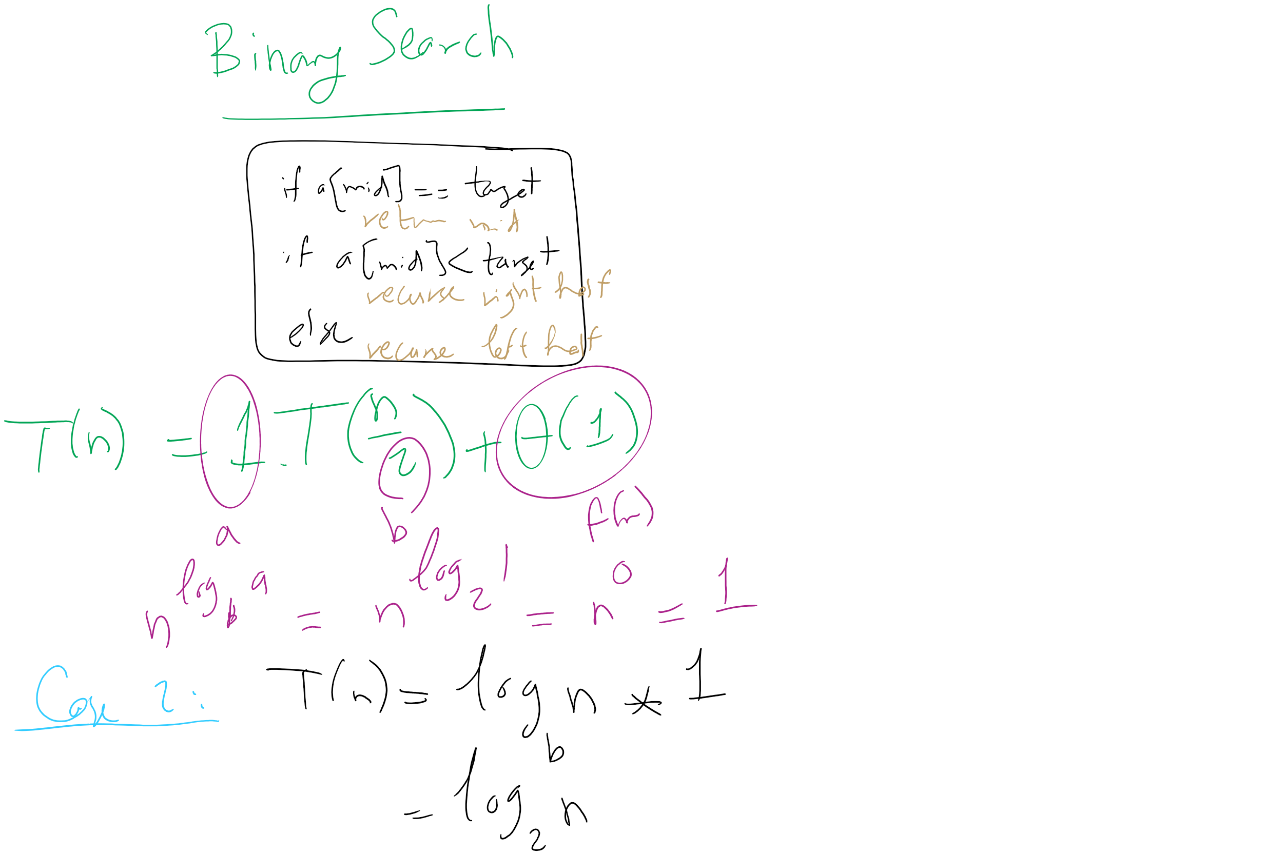
Binary Search Master Theorem Analysis

Slide 65
For our divide and conquer multiplication approach
T(n) = 4T(n/2) + Θ(n)
a = 4
b = 2
f(n) is Θ(n)
So...
n^{log_b(a)} = …
n^{lg 4} = n²
If f(n) is O(n^{log_b(a) - ε}):
T(n) is Θ(n^{log_b(a)})
If f(n) is Θ(n^{log_b(a)})
T(n) is Θ(n^{log_b(a)} lg n)
If f(n) is Ω(n^{log_b(a) + ε}) and (a * f(n/b) <= c * f(n)) for some c < 1:
T(n) is Θ(f(n))
Being Θ(n) means f(n) is polynomially smaller than n²
T(n) = Θ(n^{log_b(a)}) = Θ(n^{lg 4}) = Θ(n²)

Slide 66
@#$%^&*
Leaves us back where we started with the grade school algorithm…
Actually, the overhead of doing all of the dividing and conquering will make it slower than grade school

Slide 67
SO WHY EVEN BOTHER?
Let’s look for a smarter way to divide and conquer
Look at the recurrence relation again to see where we can improve our runtime:
T(n) = 4T(n/2) + Θ(n)
Can we reduce the amount of work done by the current call?
Can we reduce the number of subproblems?
Can we reduce the subproblem size?

Slide 68
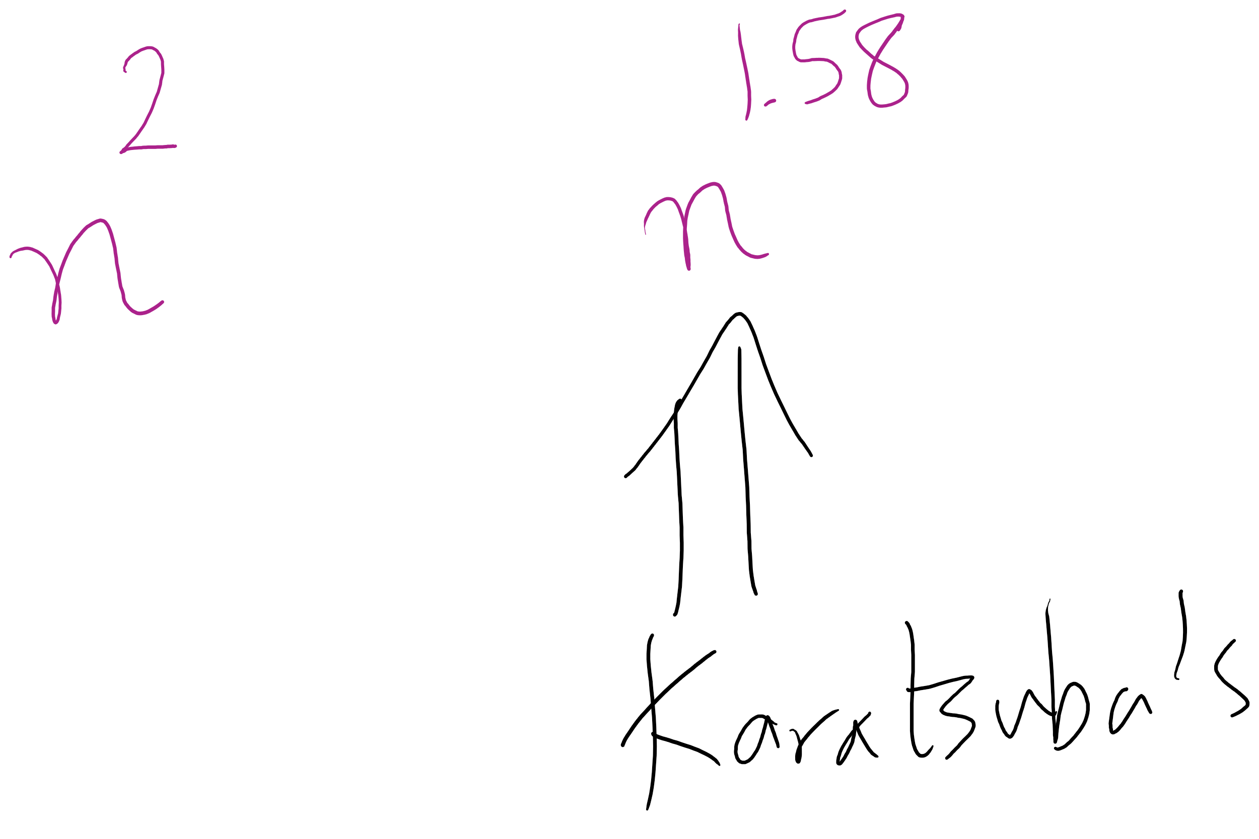
Karatsuba runtime
To get M5, we have to multiply (at most) n/2 + 1 bit ints
Asymptotically the same as our other recursive calls
Requires extra additions and subtractions…
But these are all Θ(n)
So, the recurrence relation for Karatsuba’s algorithm is:
T(n) = 3T(n/2) + Θ(n)
Which solves to be Θ(n^{lg 3})
Asymptotic improvement over grade school algorithm!
For large n, this will translate into practical improvement

Slide 69
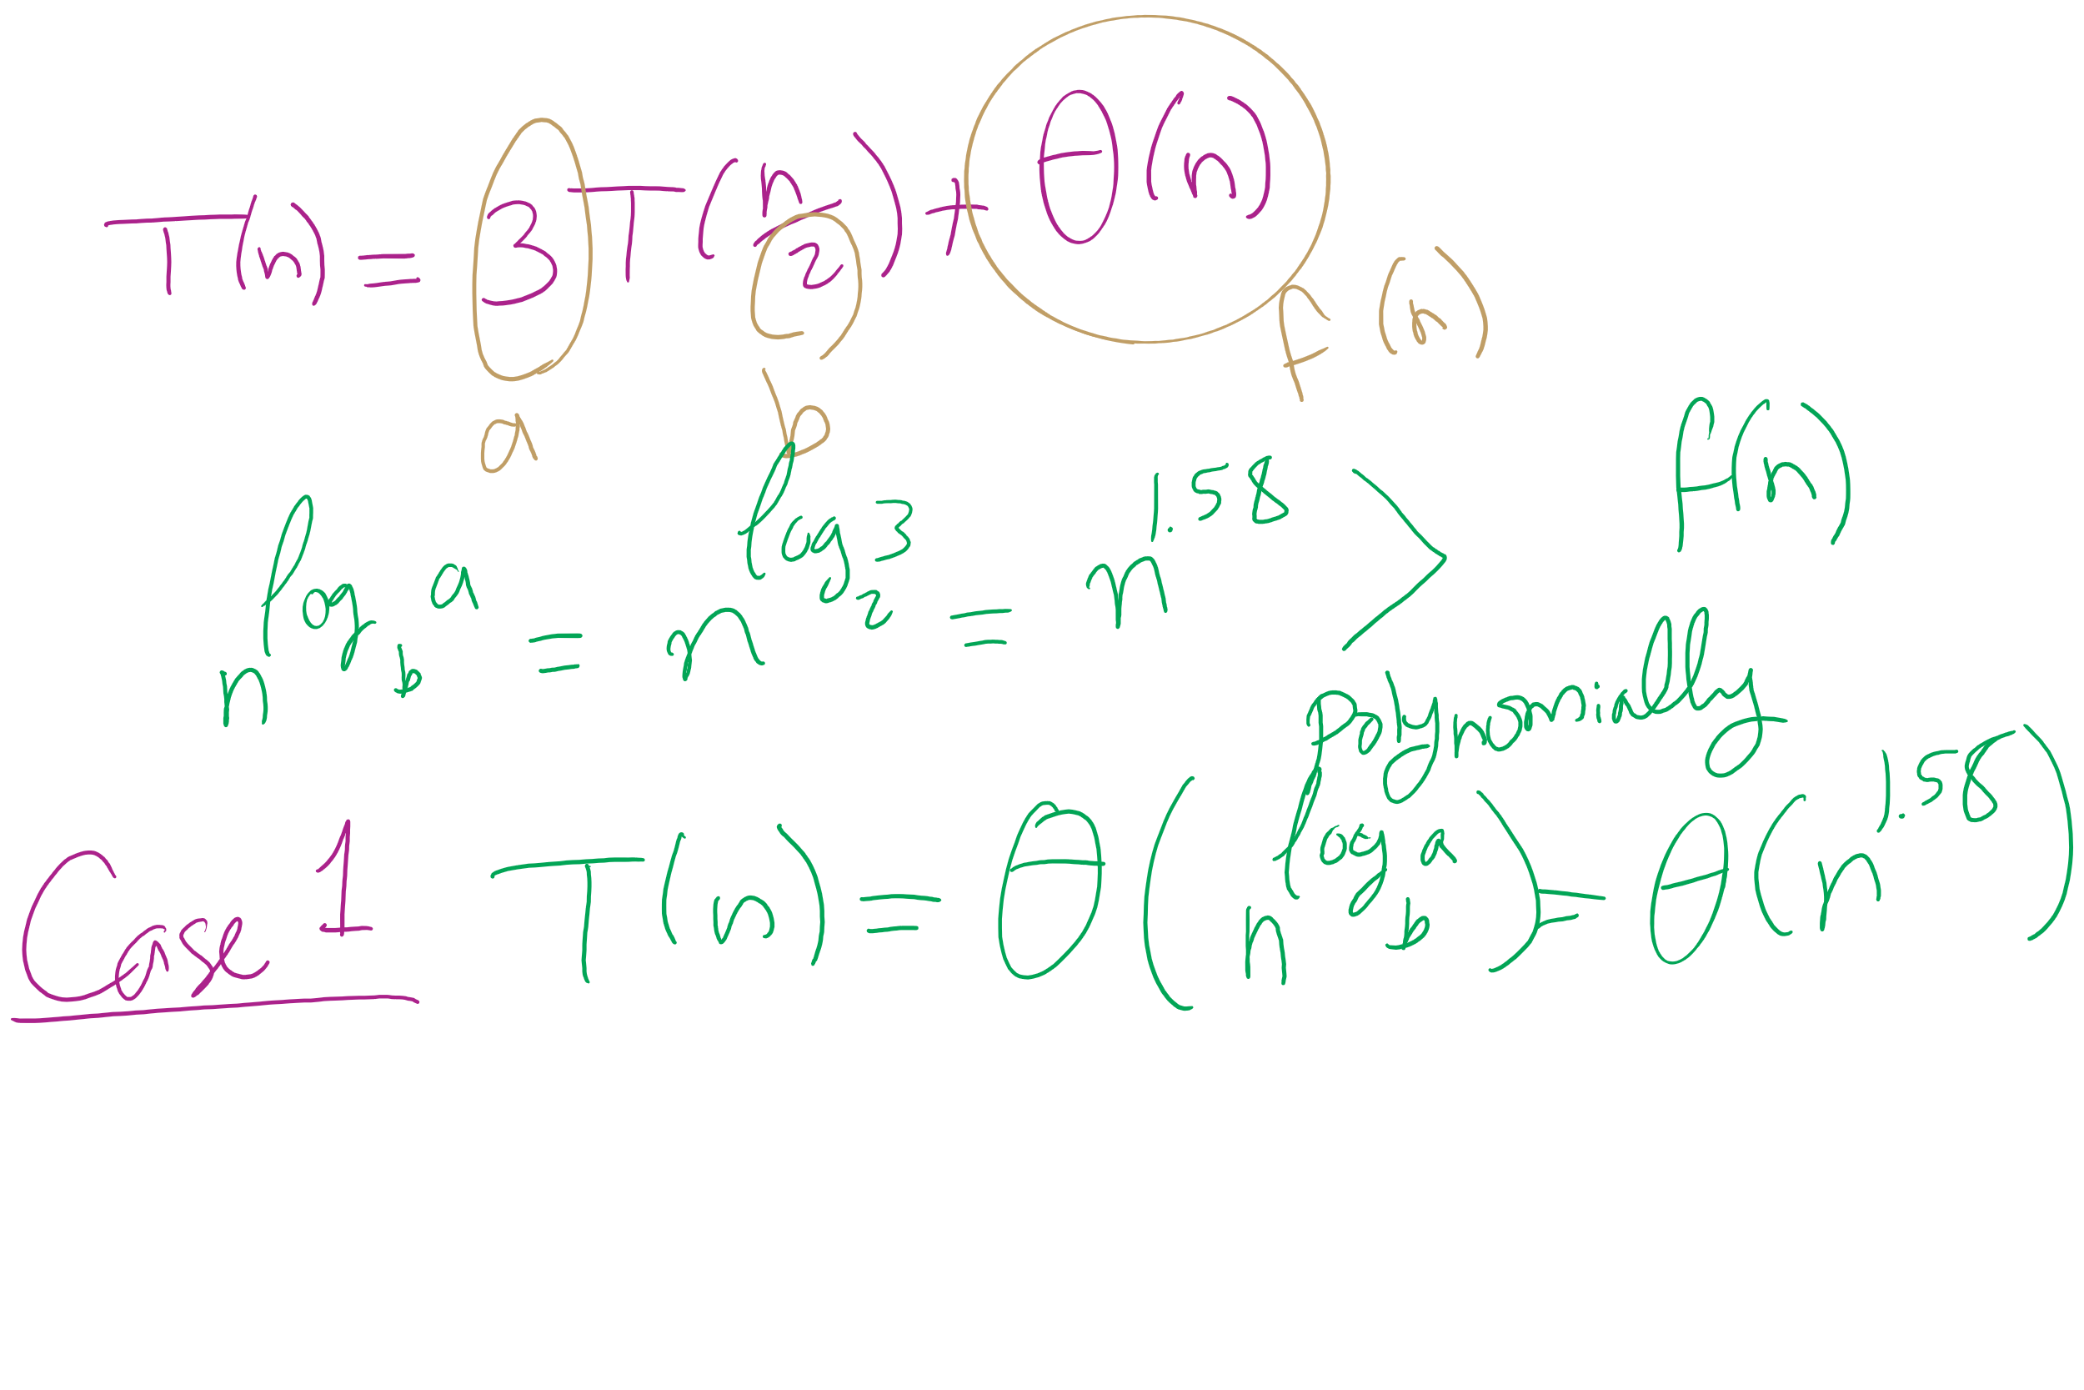
Karatsuba Runtime

Slide 70
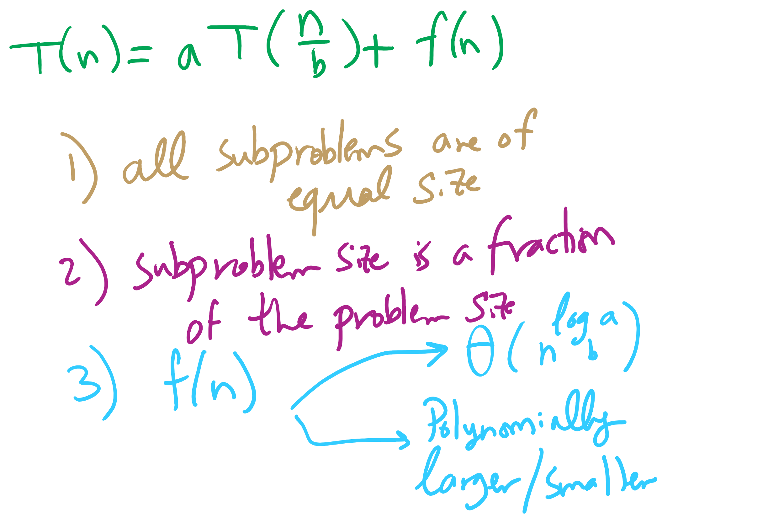
Master Theorem Conditions

Slide 71
Building another recurrence relation
x^{y} = (x^{(y/2)})² = x^{(y/2)} * x^{(y/2)}
Similarly, (x^{(y/2)})² * x = x^{(y/2)} * x^{(y/2)} * x
So, our recurrence relation is:
T(n) = T(n-1) + ?
How much work is done per call?
1 (or 2) multiplication(s)
Examined runtime of multiplication last lecture
But how big are the operands in this case?

Slide 72
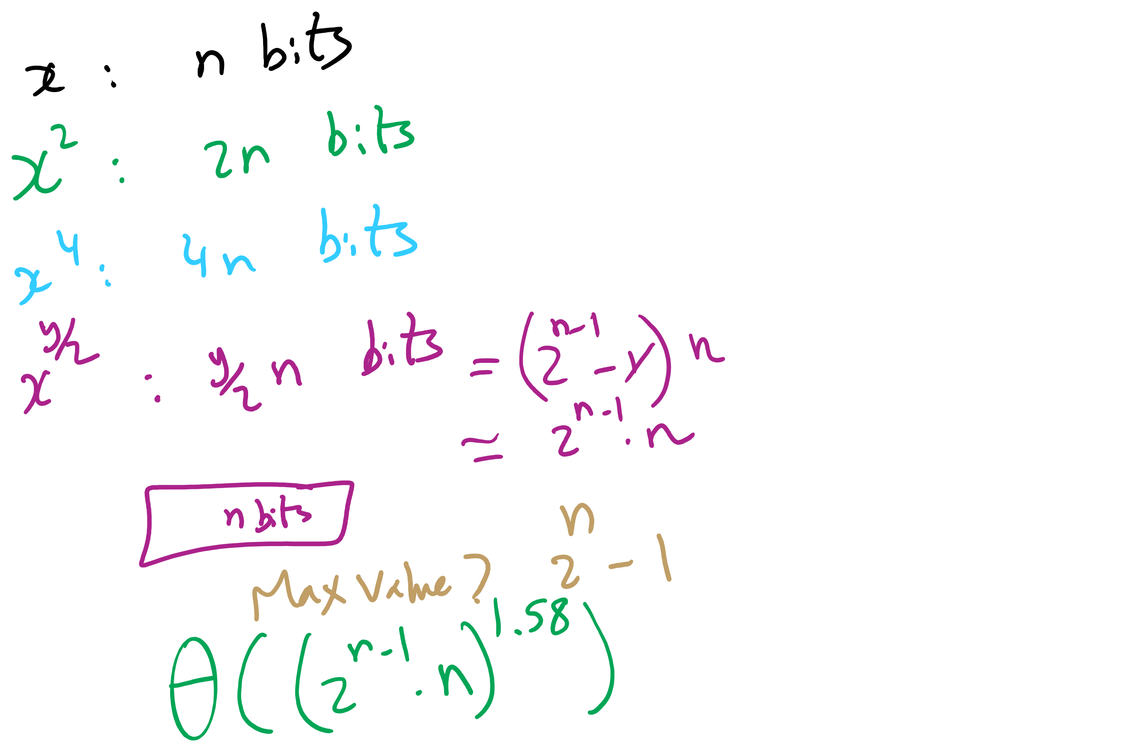
Non-recursive Work

Slide 73
Determining work done per call
Base case returns x
n bits
Base case results are multiplied: x * x
n bit operands
Result size?
2n
These results are then multiplied: x² * x²
2n bit operands
Result size?
4n bits
…
x^{(y/2)} * x^{(y/2)}?
(y / 2) * n bit operands = 2^{(n-1)} * n bit operands
Result size? y * n bits = 2^{n} * n bits

Slide 74
Multiplication input size increases throughout
Our recurrence relation looks like:
T(n) = T(n-1) + Θ((2^{(n-1)} * n)²)
squared from the use of the gradeschool algorithm
multiplication input size

Slide 75
Runtime analysis
Can we use the master theorem?
Nope, we don’t have a b > 1
OK, then…
How many times can y be divided by 2 until a base case?
lg(y)
Further, we know the max value of y
Relative to n, that is:
2^{n}
So, we have, at most lg(y) = lg(2^{n}) = n recursions

Slide 76
Please submit your reflections by using the CourseMIRROR App
If you are having a problem with CourseMIRROR, please send an email to coursemirror.development@gmail.com
Notes:
All right!
Upcoming Due Dates at A Glance

